Slide 1
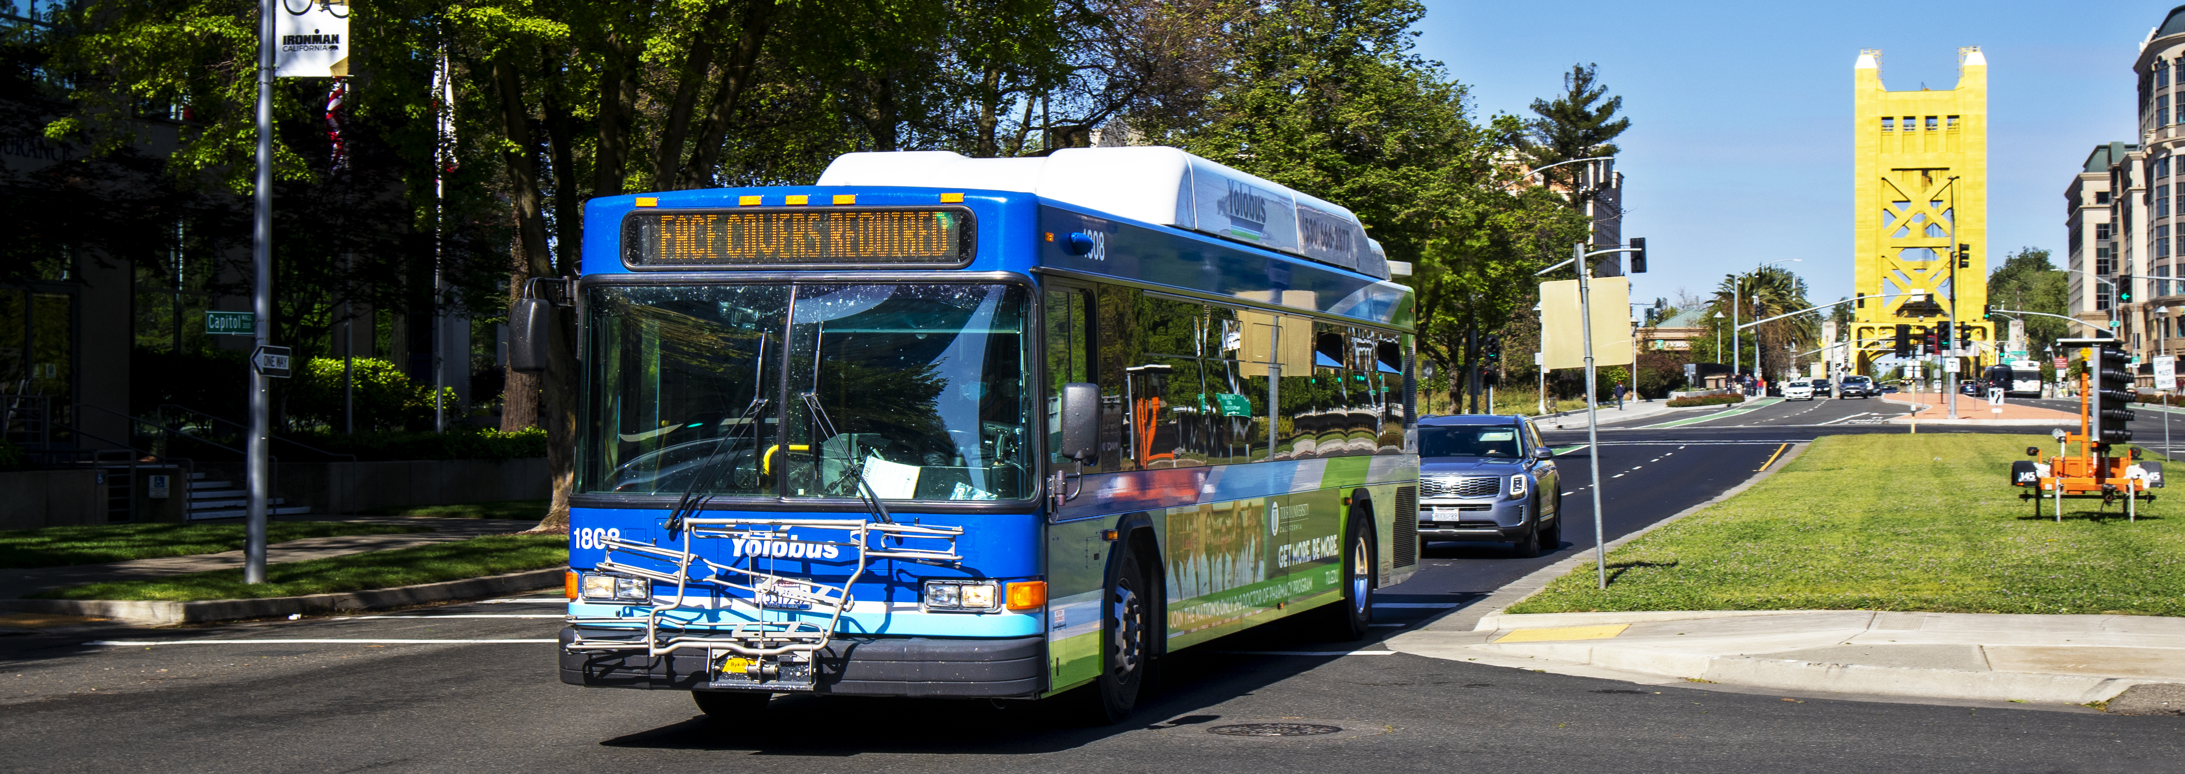
Board of Directors Meeting
February 9, 2026
1

Slide 2
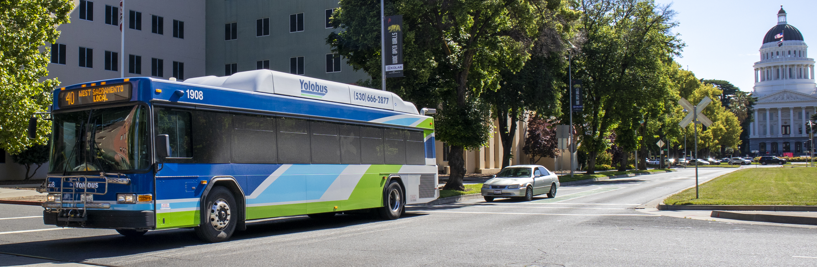
Agenda Item 1 : Call to Order/Roll Call
Agenda Item 2: Approve Agenda for Feb 9, 2026, Meeting
Agenda Item 3: General Public Comments
2

Slide 3
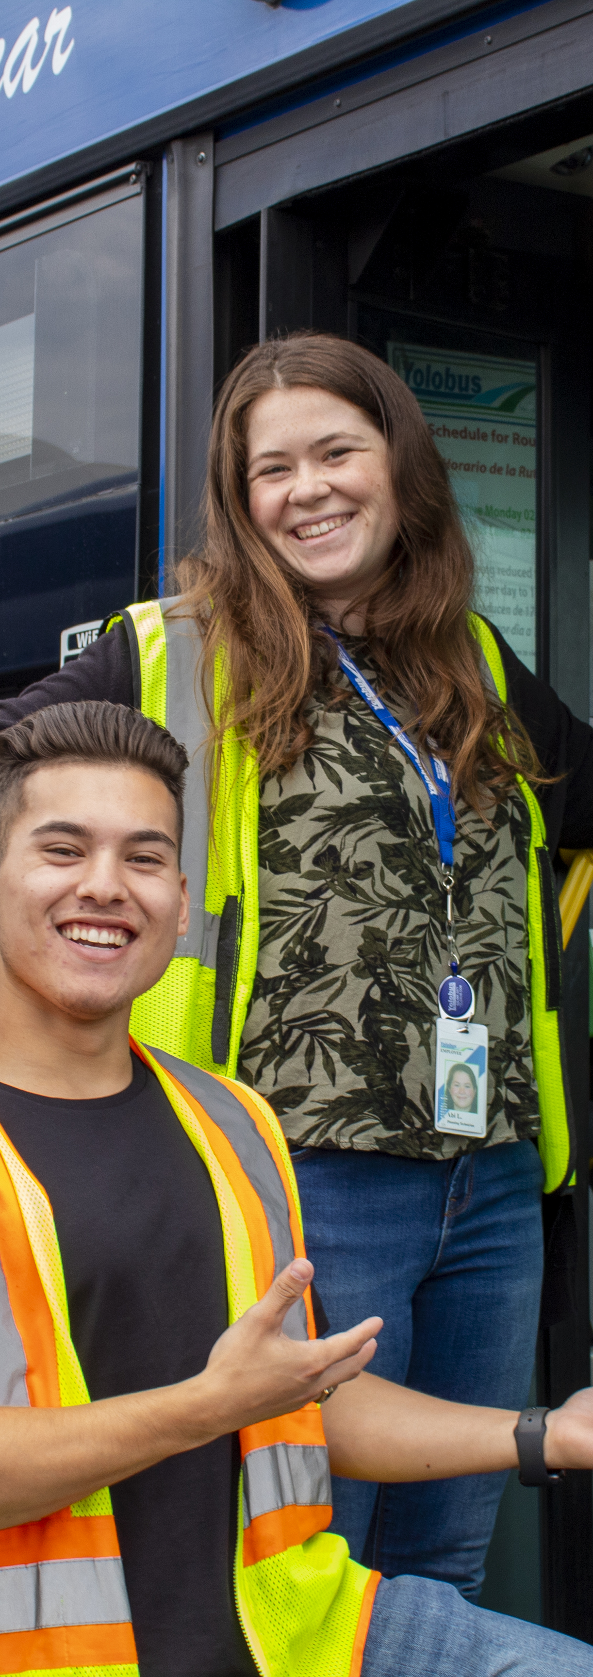
Agenda Item 4
Consent Calendar
4a | Approve Board Minutes for Regular Meeting of Jan 12, 2026
4b. | FY 2025-26 Financial and Internal Controls Update for October– December 2025 (Q2)
4c | Adopt Resolution 2026-02 to Accept funding from Affordable Housing and Sustainable Communities Grant
4d | Appoint Two New Members to Citizens Advisory Committee

Slide 4

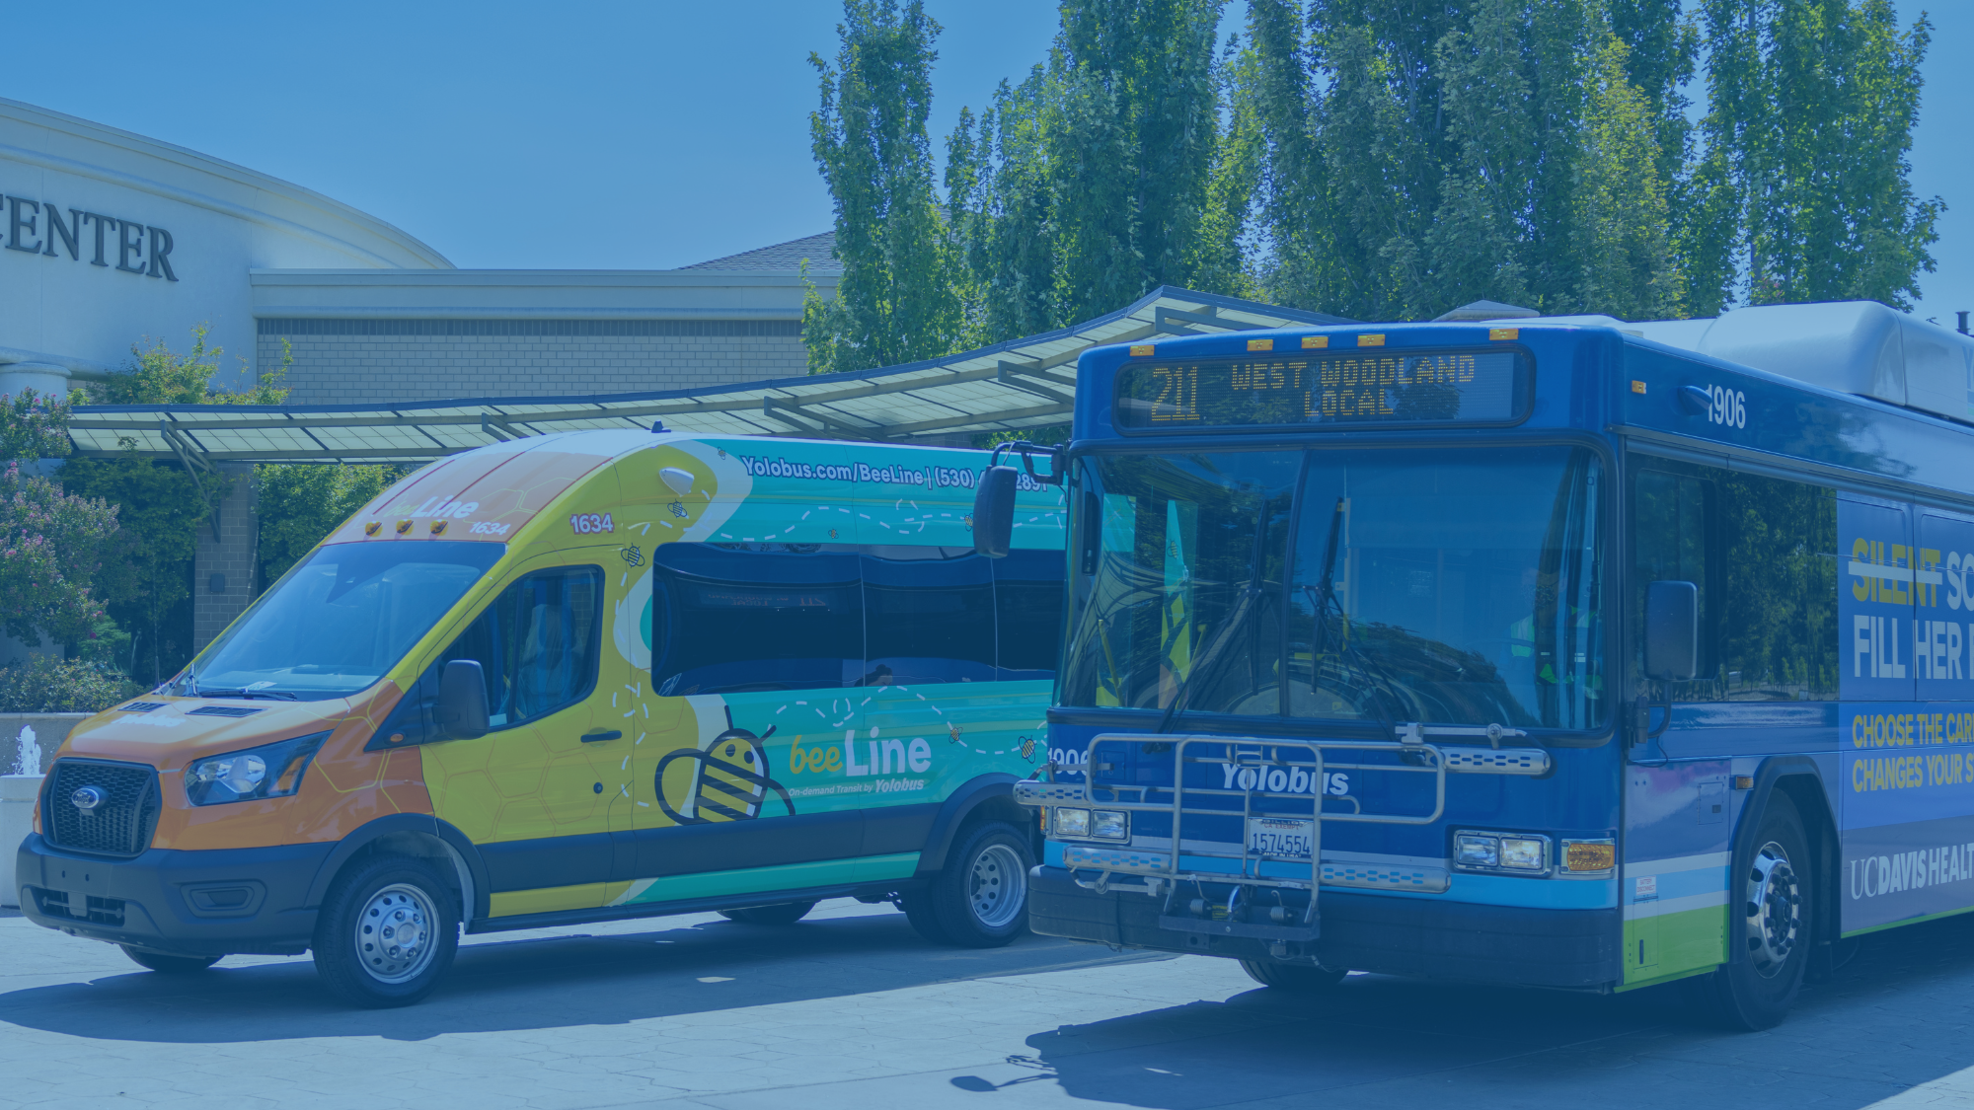
BUDGET WORKSHOP
Options for Increasing Revenues to Address Future Deficits
YoloTD Board of Directors Meeting
FEB 9, 2026

Slide 5
Table of Contents:
Introduction & Background
Refresher on budget workshop series
Recap of Workshop #1
Estimating YoloTD’s future deficit
Goals and structure of this workshop

Slide 6
Table of Contents:
Six Options for Increasing Revenue
Increase share of federal funding
Continue state transit recovery (SB 125) funding
VMT mitigation
Toll revenue from Yolo 80 managed lanes
Increase share of LTF Revenue
Voter-approved transportation sales tax measure

Slide 7
Introduction & Background

Slide 8
Refresher on Budget Workshop Series
This workshop series was an outcome of FY 24-25 budget process​
Goals
Broader understanding of YoloTD funding sources and budgeting process​
Explore options to address future deficits​
Promote learning > Set direction ​
​
Three Workshops ​
Overview of Major Funding Sources (Federal/State) - May 2025​
Options for Increasing Revenues – Feb 2026​
Budgeting Process – how costs are allocated to funding sources – Mar 2026

Slide 9
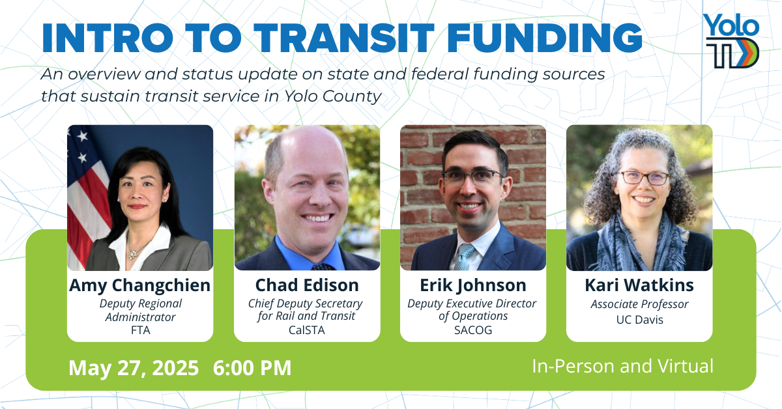
Workshop 1: Major Funding Sources
RECAP

Slide 10
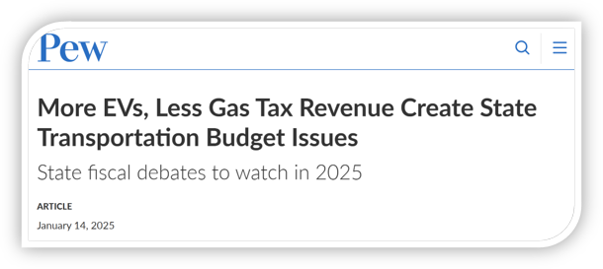
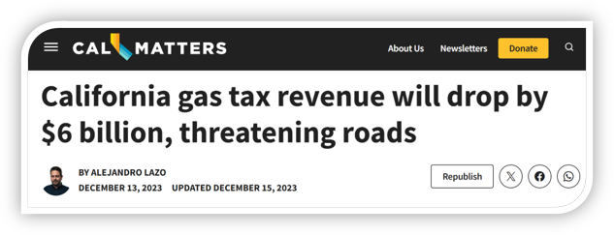
Long-term, transportation revenues for roads and transit are projected to decline​

Slide 11




Similar slowdown anticipated for TDA revenues​
FUND
TAX
OUTLOOK
Local Transportation
Fund (LTF)​
0.25% sales tax on goods​
Mixed bag: Consumer spending is decreasing, slower growth overall
1
State Transit Assistance
Fund (STA)​
7.625% sales tax on diesel fuel ​
Declining: $300 million
less revenue by 2034
2
Source: (1) “Updated Big Three Revenue Outlook”, Legislative Analyst’s Office; (2) “Assessing California’s Climate Policies: Implications for State Transportation Funding and Programs”, Legislative Analyst’s Office.​

Slide 12
Transit Transformation Task Force
The Transit Transformation Task Force was a statewide panel created by Senate Bill 125 (SB 125) in 2023 to develop strategies for revitalizing and modernizing public transit across California.
The Task Force was established in response to declining ridership and financial instability at many transit agencies—problems worsened by the COVID-19 pandemic.
Mission: identify both short- and long-term reforms to make transit more efficient, equitable, and financially sustainable.
The California State Transportation Agency (CalSTA) convened the 25-member Task Force, which included representatives from transit agencies, local governments, labor unions, environmental organizations, business groups, academics and rider advocates.

Slide 13
Estimating YoloTD’s Future Deficit

Slide 14
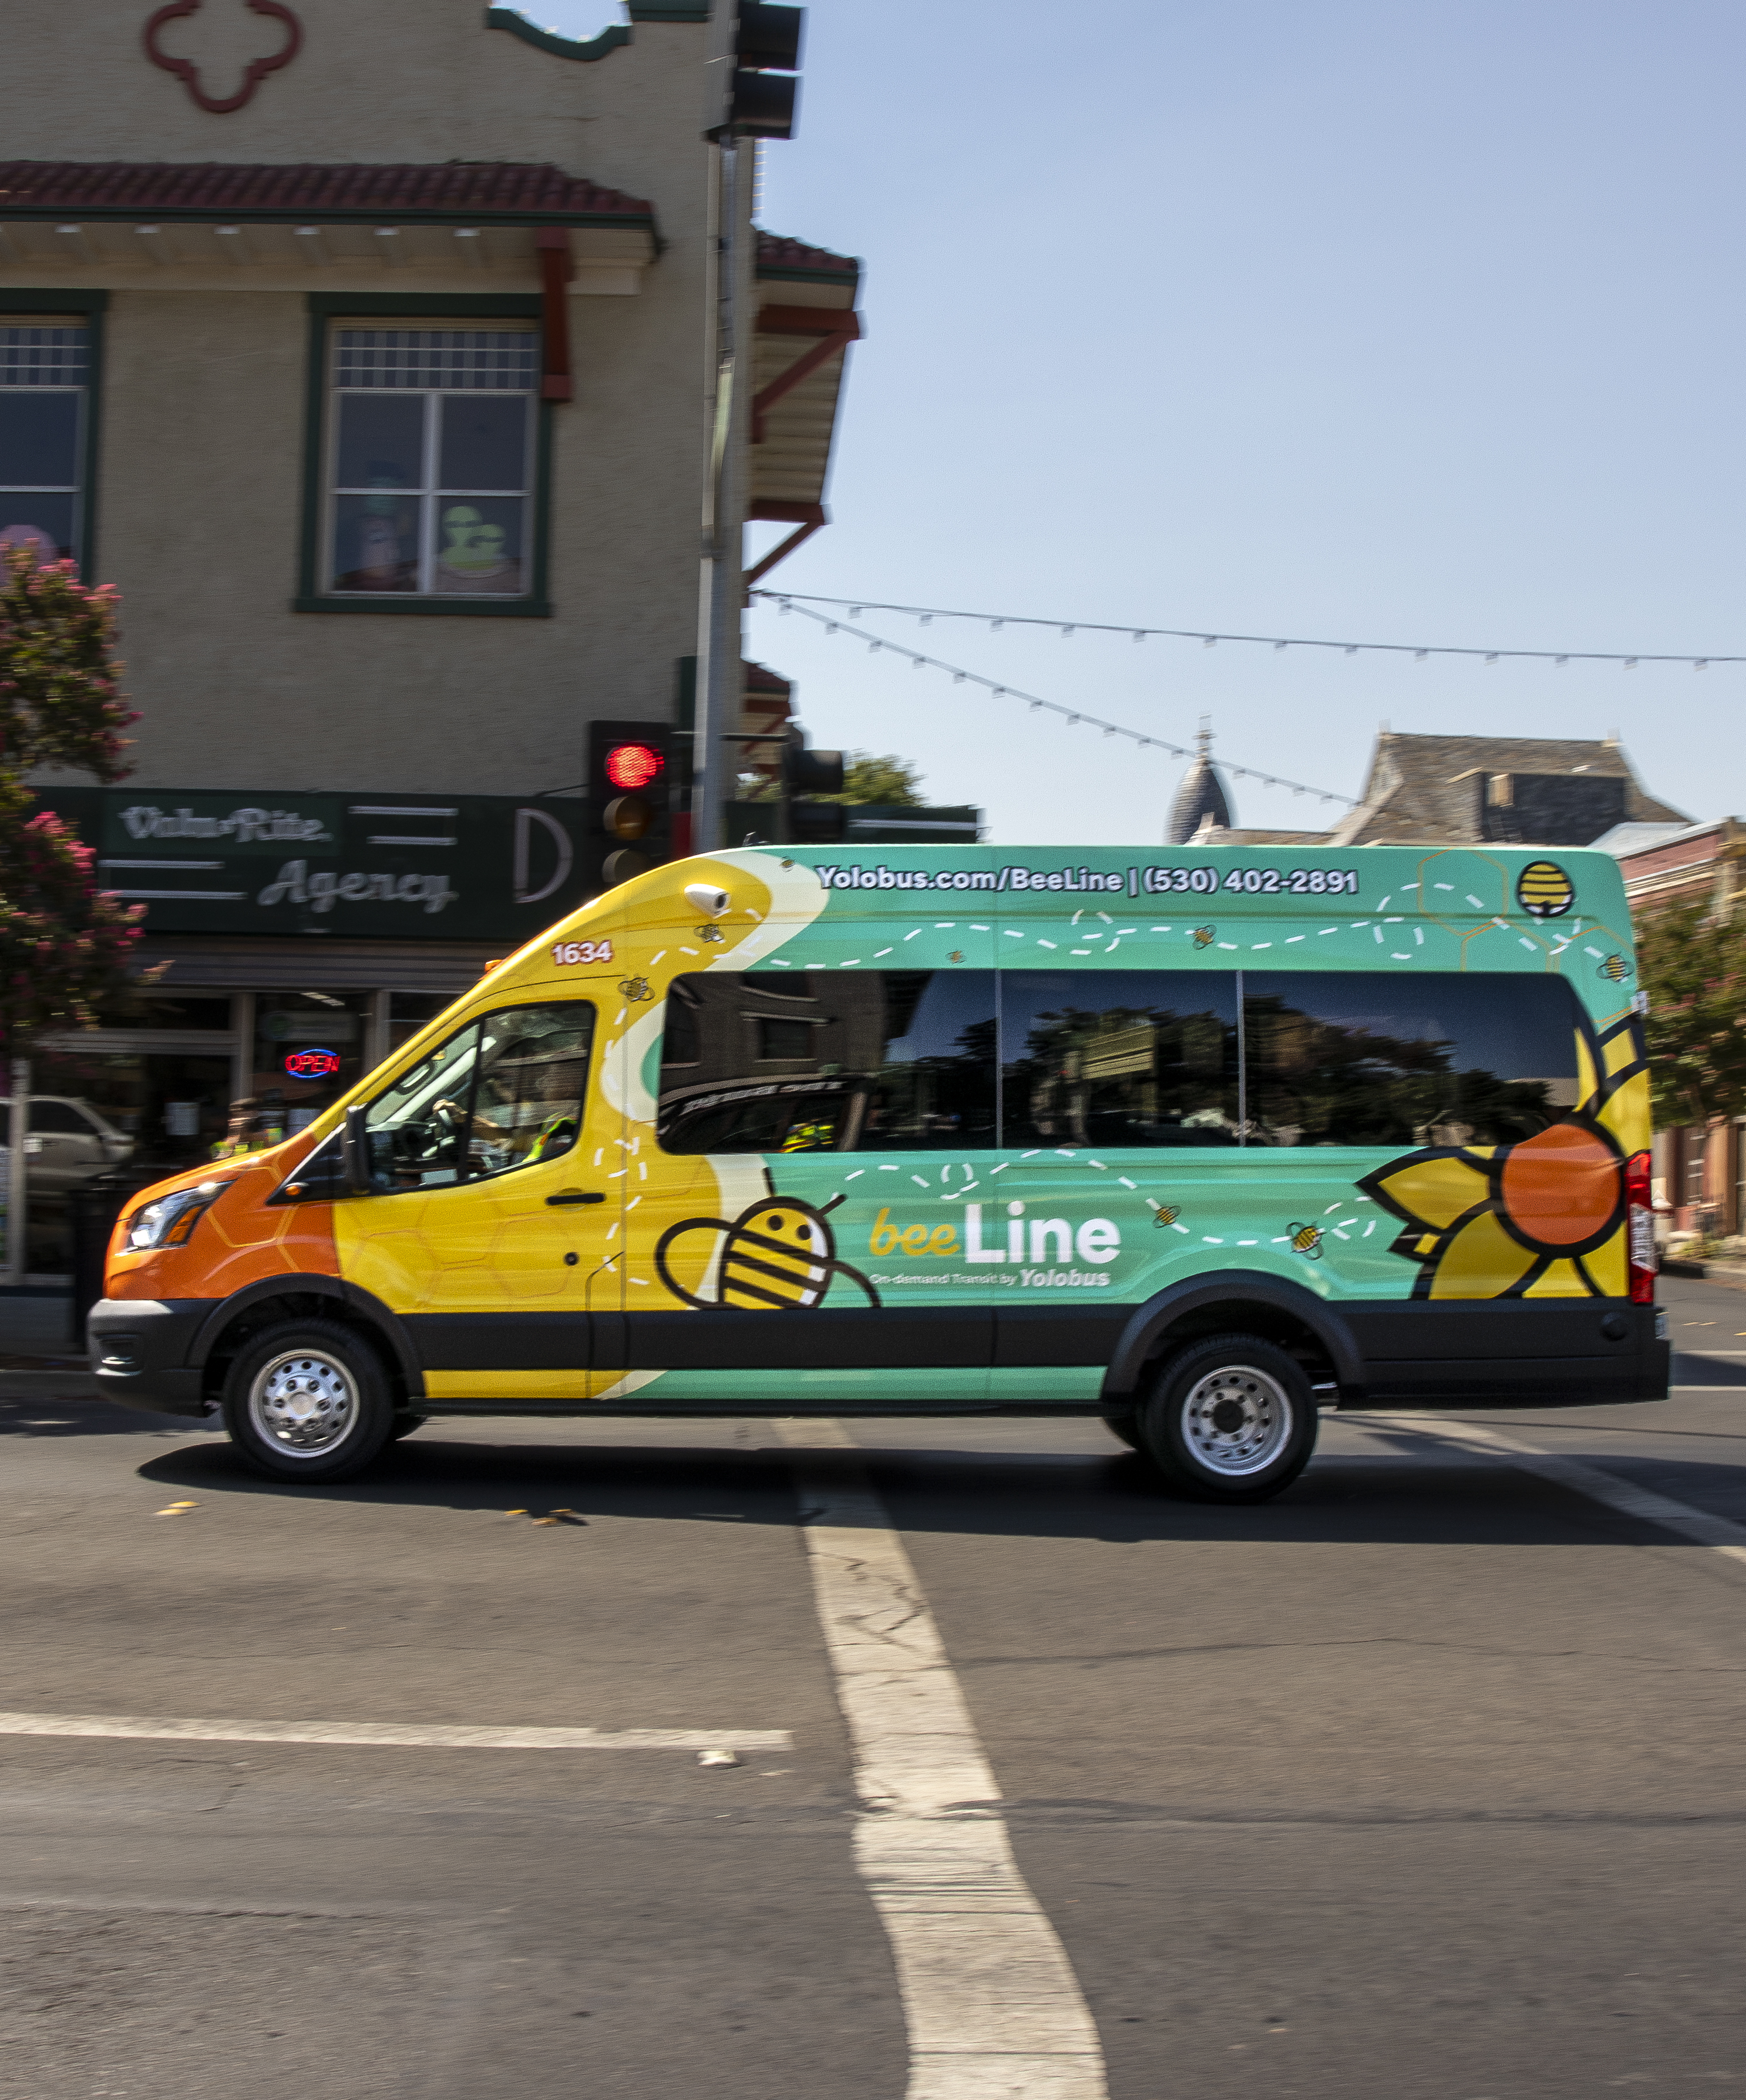
YoloTD structural deficit
Five-Year Outlook adopted in June 2025 relies on one-time recovery funds and accumulated savings to maintain current service levels through FY 29-30.
(see next slide)
​
Does not account for increased costs of new transit operations contract ​
Assumes fleet replacement and zero-emission transition are funded separately through discretionary grants.​
Assumes expenses and revenues grow at same rate.​
​
​
​

Slide 15
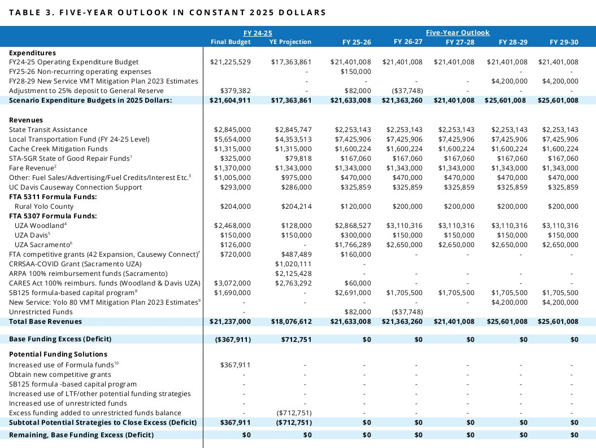

Slide 16
YoloTD structural deficit
For purposes of this discussion, we estimate an annual structural deficit of $5-$8 million per year due to some combination of the following:​​
Increased costs of new transit operations contract​
(bids are due Feb 10)
Urgent fleet replacement needs not fully funded by grants​
Federal transit funds may decline in next transportation bill
​
​
​

Slide 17
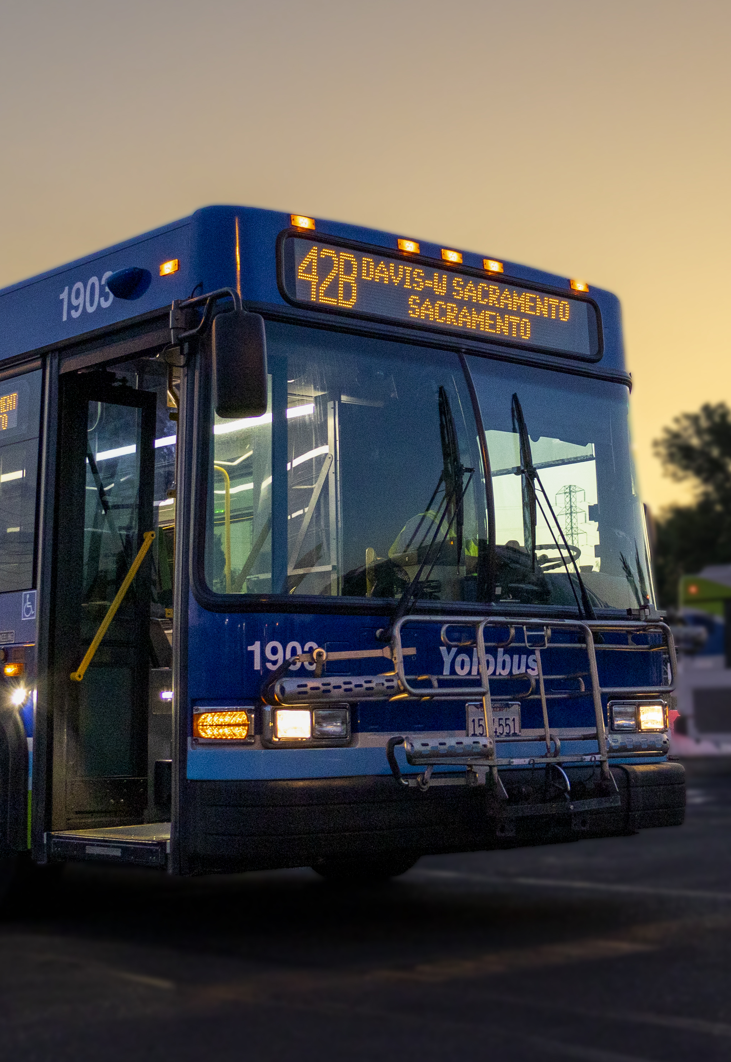
What happens if structural deficit is not addressed?​
Reductions in transit service, using the Short Range Transit Plan’s 80% and 90% scenarios as guideposts​
Delayed transition to zero-emission fleet – a move which could jeopardize state funding
Layoffs​ of frontline workers and administrative staff
​
​

Slide 18
Goals for today’s workshop
Explore options for increasing revenue ​
Identify areas where additional research/exploration is desired​
Return for future Board action on which options to pursue​
​
​

Slide 19
Looking at each option
How the funding mechanism works​
Current funding levels for YoloTD​
What is the range of additional funding YoloTD could receive? ​Would it contribute meaningfully to closing the deficit?​
What is the process for getting additional funding?
Potential next steps​
Qualitative scoring:
​
​
REVENUE GENERATION POTENTIAL
POLITICAL FEASIBILITY
EASE OF IMPLEMENTATION
EXAMPLE
SELL COOKIES
AT BUS STOPS
High
Medium
Low

Slide 20
Six Options

Slide 21
INCREASE SHARE OF FEDERAL FUNDING
Option 1

Slide 22
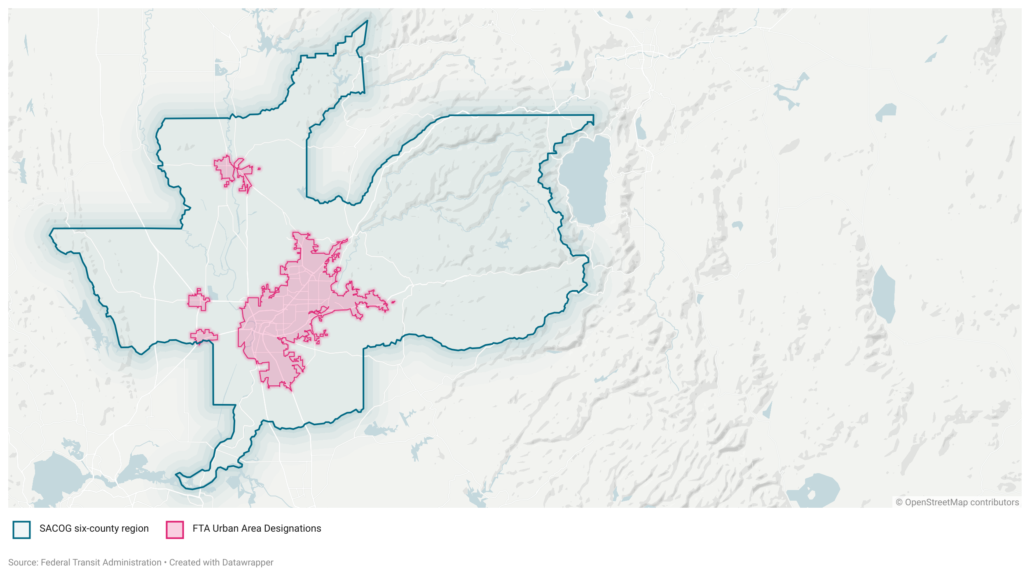
Most federal transit funding for YoloTD flows through three urban areas
Urban area |  | Population | FTA 5307 funding in FY25 ($M) | YoloTD Share
1 | Sacramento (formula) | 1,946,618 | $37.6 | $1.2
1 | Sacramento (grants) | --- | $4.2 | varies
2 | Woodland | 61,133 | $2.5 | $2.5
3 | Davis | 77,034 | $6.2 | $0.15
 | Total |  | $50 | $3.85
2
1
3

Slide 23
Federal Funding: Sacramento UZA
  Federal transit funds for the Sacramento Urbanized Area are shared among YoloTD, SacRT, and other small transit operators in Placer and El Dorado Counties.
  Funding supports Yolobus West Sacramento local routes as well as Intercity Route 42A/B
  Funding levels dictated by 2015 MOU:
    88% by formula
    12% by competitive grant program
Sacramento UZA
$38m per year

Slide 24
Federal Funding: Sacramento UZA
  Status of MOU Negotiations
  SacRT is proposing to eliminate competitive grant program, allocate all funds by formula.This would result in more predictability but less funding for YoloTD.
  Proposed changes to formula methodology would further decrease YoloTD’s formula share.
  Likely Impact on YoloTD Budget
  In best case scenario, there is no change to YoloTD funding levels ($1-1.2 million formula + $0.5-1m in grants per year)
  In worst case scenario, YoloTD funding levels decline
  ($0.8-1m formula + no grants)
Sacramento UZA
$38m per year

Slide 25
Federal Funding: Davis UZA
Federal transit funds for the Davis Urbanized Area are shared by Unitrans and Yolobus.
Funding supports Yolobus Davis Express Routes 43, 43R, 44 and 230 as well as Intercity Route 42A/B.
Funding levels for Davis UZA allocated by historical practice:
Typically $150k to YoloTD ($300k in FY 2026)
Remainder to Unitrans (currently ~$6m)
Davis UZA
$6.2m per year

Slide 26
Federal Funding: Davis UZA
Student fees cover 71% of Unitrans operating costs. Unitrans uses federal funding to cover remaining operating costs, and for fleet maintenance and repair. (Historically, Unitrans has not received TDA funds).
However, the Yolobus fleet is significantly older and in greater need of replacement. FTA uses average lifetime miles to track fleet condition. By this measure, Yolobus’s fleet replacement needs are more than double that of Unitrans.
Yolobus fleet: 477,000 avg lifetime miles
Unitrans fleet: 212,000 avg lifetime miles
Source: National Transit Database 2024
Davis UZA
$6.2m per year

Slide 27

Federal Funding: Big Picture
Transit funding levels are established by Congress every ~5 years via broad-based transportation funding bill (aka “Highway Bill”).
The current transportation authorization bill passed in 2021 and expires September 2026.
There is no draft bill yet, but transit funding is predicted to remain steady or decline.

Slide 28
Increase Share of Federal Funding:
Qualitative Scoring and Potential Next Steps
REVENUE GENERATION POTENTIAL
POLITICAL FEASIBILITY
EASE OF IMPLEMENTATION
INCREASE SHARE OF FEDERAL TRANSIT FUNDING
Low
Medium
Low
Potential Next Steps:
Continue negotiations on Sacramento UZA MOU to preserve current earned share and competitive grant program
Negotiate with Unitrans/City of Davis to establish Davis UZA MOU
Support advocacy for transit funding in federal Highway Bill

Slide 29
CONTINUE STATE TRANSIT RECOVERY (SB 125) FUNDING
Option 2

Slide 30
What is SB 125?
Passed in 2023, provides $5.1 billion in one-time, flexible emergency funding to transit agencies in California. It was intended to stave off transit cuts brought about by declining ridership and revenues post-COVID. These funds administered by SACOG for the four-county region that includes Yolo, Sacramento, Yuba and Sutter.
The bill also created a statewide Transit Transformation Task Force to develop policies to help transit recover long-term. SACOG is also required to create a Long-Term Financial Plan & Recovery Strategy for transit in the SACOG region. That work is underway.

Slide 31
Current SB 125 Funding Awards to YoloTD
SACOG has administered two cycles of SB 125 funding to date. The third (and final!) cycle is currently underway.
YoloTD has received the following allocations:
    Cycle 1: $3 million
    Cycle 2: $3.3 million
    Cycle 3: TBD
YoloTD staff hope Cycle 3 funds can absorb impact of new transit operations contract for the next 3-5 years

Slide 32

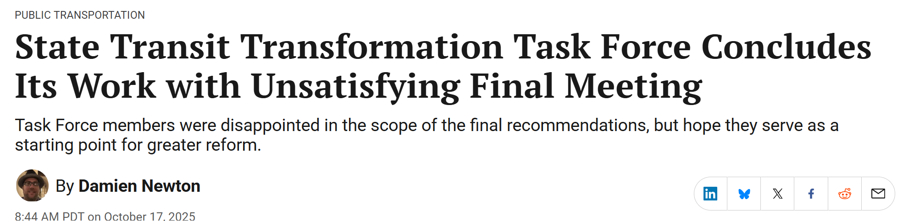
Task force does not identify clear path forward to address fiscal cliff.
Task Force Final Report (Dec 2025) includes the following recommendations on funding:
Implement new state funding mechanisms to stabilize transit agencies in the near term, increase and enhance transit service in the mid-term, and deliver transit service that aligns with the goals of the report over the long-term.
Consider additional flexibility for transit agencies, regions or voters to place measures on the ballot.
Allow maximum flexibility to transit agencies when expending State transportation funds, and MPOs to flex federal highway dollars for transit.

Slide 33
State Transit Recovery (SB 125) Funding:
Qualitative Scoring and Potential Next Steps
REVENUE GENERATION POTENTIAL
POLITICAL FEASIBILITY
EASE OF IMPLEMENTATION
CONTINUED STATE TRANSIT RECOVERY FUNDING
Medium
High
Low
Potential Next Steps:
Advocate for maximum share of Cycle 3 funding from SACOG
Support advocacy for renewed state transit funding

Slide 34
VMT MITIGATION
Option 3

Slide 35
What is VMT Mitigation?
VMT mitigation is now a required component of CEQA analysis for any project that will generate new car trips.
Capacity-expanding road or highway projects
Auto-dependent housing, office and retail developments
Strategies that increase transit ridership, such as increasing transit frequency or access to key destinations, have been demonstrated to reduce VMT.
This change in CEQA came after the passage of legislation (SB 743).
VMT mitigation programs are evolving rapidly. Yolo 80 was among the first highway projects statewide to comply with the new requirements.

Slide 36
VMT Mitigation for Yolo 80 Project
YoloTD is slated to receive ~$5.5 million annually starting in FY 2028 from Yolo 80 construction capital funds.
These investments may continue beyond initial mitigation period, pending availability of toll revenue.
These funds are slated for expansion of transit service including the 42A/B and Causeway Connection, not continuation of current service.
A major expansion of Yolo Commute, the commuter incentive program administered by YoloTD, is also programmed for VMT mitigation funding from the Yolo 80 project.

Slide 37
Aside from Yolo 80, are there other opportunities to receive VMT mitigation funding?
Yes!
I-5 tolling project in Sacramento County could be another source of VMT mitigation funding, particularly for Intercity Route 42A/B
Housing and commercial developments are another option. YoloTD has discussed VMT mitigation opportunities with multiple project applicants navigating the approvals process.
Fully funding new or expanded transit service is not financially feasible for most developments of the size and scale we see in Yolo County. However, partial funding of new/expanded transit service could be an option.

Slide 38
VMT Mitigation Banking
In response to SB 743, agencies across California are working to establish VMT mitigation “banks”
What is a VMT mitigation bank?
SB 743 implementation guidelines allow regional agencies to create VMT mitigation banks. These banks sell VMT “credits” to project proponents, and then use the pooled credits to implement VMT mitigation measures.
Agencies participating in a mitigation bank must identify high-priority projects that can be reasonably implemented using pooled funds or credits, and demonstrably achieve quantifiable VMT reductions.
Similar approach has been used for affordable housing, habitat, and open space projects.

Slide 39
How would YoloTD engage in VMT Mitigation Banking?
Work with SACOG and other counties to develop a regional VMT mitigation bank.
Explore participation in California statewide mitigation bank for significant transportation impacts (Pursuant to AB 130, 2025).
Work with YoloTD member jurisdictions to create a Yolo-specific VMT Mitigation banking program focused on projects and programs that serve Yolo County.

Slide 40
VMT Mitigation Funding:
Qualitative Scoring and Potential Next Steps
REVENUE GENERATION POTENTIAL
POLITICAL FEASIBILITY
EASE OF IMPLEMENTATION
VMT Mitigation
Medium
Low
Medium
Potential Next Steps:
Research best practices and emerging models in VMT mitigation banking
Engage with regional and statewide VMT mitigation banks under development

Slide 41
TOLL REVENUE FROM YOLO 80 MANAGED LANES
Option 4

Slide 42
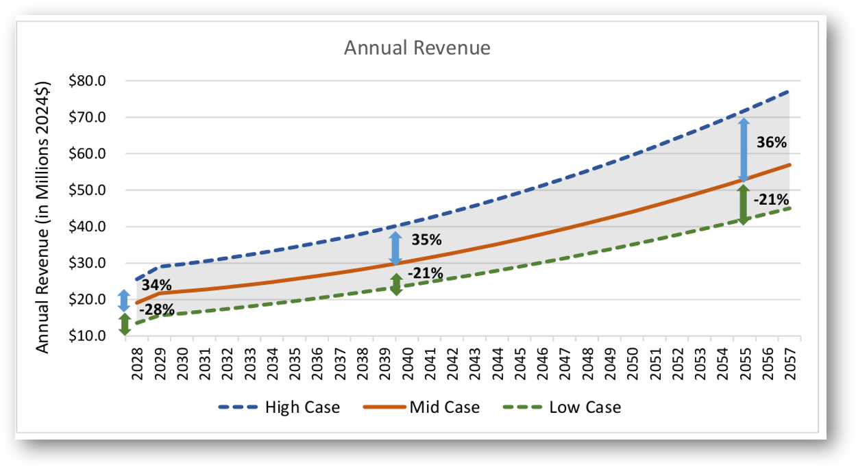
Overview of Toll Revenue
The Yolo 80 managed lanes project is expected to generate $14-26 million per year in gross revenue when lanes opens in 2028. Revenue is projected to grow over time.

Slide 43
‘Net Excess’ Toll Revenue
After all operating expenses (including VMT mitigation), net excess toll revenue will be available for other transportation needs.
What projections do we have about net excess toll revenue?
CARTA has not yet published projections of net excess toll revenue. Major cost drivers are still being developed. In addition to regular operating costs, CARTA will have repayment of startup loans for the first 5-10 years of lane operations.
Net excess toll revenue unlikely before 2035, and amount is not yet known. There will be other, competing priorities for that revenue. Available funding could be significant in the mid- to long-term, but not soon enough to address near-term deficits.

Slide 44
Toll Revenue from Yolo 80:
Qualitative Scoring and Potential Next Steps
REVENUE GENERATION POTENTIAL
POLITICAL FEASIBILITY
EASE OF IMPLEMENTATION
TOLL REVENUE FROM YOLO 80 PROJECT
High
High
Low
Potential Next Steps:
Continue engagement with CARTA to shape funding waterfall, CARTA loan agreements, and other budgetary factors.

Slide 45
INCREASE SHARE OF LTF FUNDING
Option 5

Slide 46
Overview of Local Transportation Fund
The Local Transportation Fund, or LTF, is California’s largest transit funding program.
Designated Uses: LTF provides for public transit planning and operations as well as coordination between transit providers.
Source of Funds: LTF is derived from a 1/4 cent of the general sales tax.
Administration: All revenues are returned to the originating county. Yolo County’s funds are administered by SACOG.
Small County Loophole: The 1971 law includes a provision allowing counties with populations under 500,000 to use their LTF for local streets and roads, if all transit needs are met, a determination made through public hearings administered by SACOG. This loophole enables non-transit spending but requires proving no unmet transit needs exist.
TDA Alphabet Soup
The terms LTF and TDA are often used interchangeably. TDA stands for Transportation Development Act, the 1971 law which established the Local Transportation Fund.
However, TDA also includes other, smaller pots of funding (STA + SGR), but those don't have the same flexibility as LTF and are for transit only.

Slide 47
LTF Allocations for FY 2025-26
(in $ millions)
Jurisdiction | Total LTF Available ($M) | Amount Used by YoloTD | Amount Retained by Jurisdiction | Percent Retained by Jurisdiction
Davis | 4.61 | 2.24 | 2.38 | 51%
Woodland | 4.30 | 2.12 | 2.12 | 49%
West Sacramento | 3.85 | 2.62 | 1.23 | 32%
Winters | 0.54 | 0.15 | 0.39 | 72%
Yolo County | 2.41 | 0.23 | 2.19 | 91%
All Jurisdictions | 13.9 | 7.43 | 8.30 | 60%

Slide 48
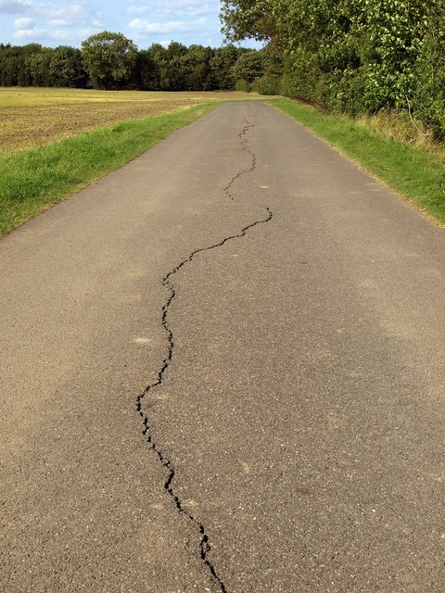
Competing Priorities
Road rehabilitation is critically underfunded in Yolo County. A 2018 YoloTD study estimated the need at $40 million per year.
Most jurisdictions in Yolo County rely upon LTF for their annual road rehabilitation budgets.
LTF also funds ridesharing (West Sacramento On-Demand), and complete streets projects in Yolo jurisdictions.

Slide 49
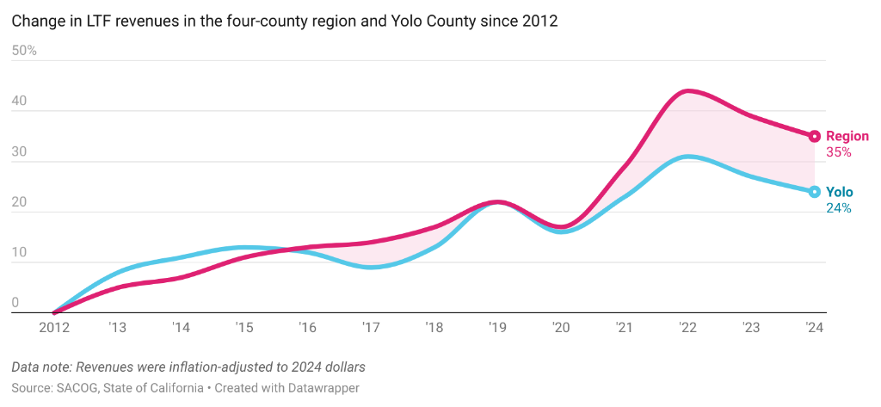
LTF revenue in Yolo County has grown, but at a slower rate than the SACOG region overall

Slide 50
Who decides how to allocate LTF?
It’s complicated.
The YoloTD Board of Directors and the City of Davis (as the operator of Unitrans) have discretion over how much LTF to claim for transit.
If YoloTD and City of Davis don’t claim all available LTF for transit, SACOG may make a determination that there are no unmet transit needs, and cities can apply to claim the excess funds for other priorities.
Reducing transit service to preserve funding for road rehabilitation may not be consistent with SACOG’s LTF guidelines and/or the TDA statute.

Slide 51
Increase Share of LTF Funding:
Qualitative Scoring and Potential Next Steps
REVENUE GENERATION POTENTIAL
POLITICAL FEASIBILITY
EASE OF IMPLEMENTATION
INCREASE SHARE OF LTF FUNDING
Low
High
High
Potential Next Steps:
Talk to jurisdictions about the impact of reducing available LTF, whether other sources of funding are available to minimize impacts
Coordinate with SACOG about implications of service reductions for Unmet Transit Needs process

Slide 52
TRANSPORTATION SALES TAX MEASURE
Option 6

Slide 53
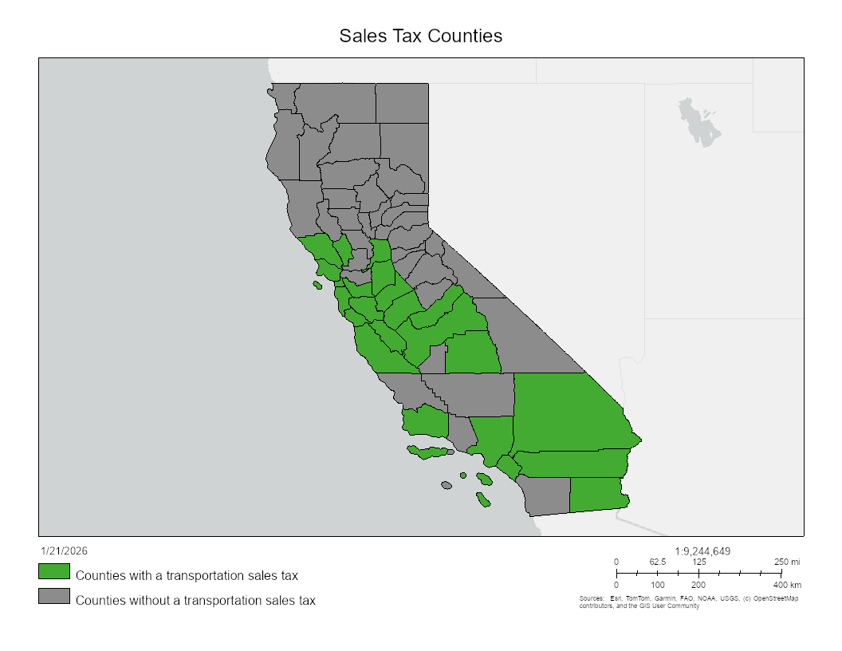
Countywide transportation sales taxes are widespread in California
25 “self-help" counties in California generate local transportation revenue via sales tax measures.
Sales tax revenue is less restrictive than state or federal funds, allowing for flexibility and innovation.
Sales tax revenue provides essential local match for competitive state/federal grants that are otherwise out of reach.
Notes:
Although a countywide transportation sales tax has not been attempted in Yolo County, these taxes have been passed in over 40% of California counties
Taxes have been passed in a diverse set of counties, not all are urban or high in population
Stanislaus, Merced, Madera
There are many benefits of sales tax revenue over other types:
Sales tax revenue has fewer restrictions than federal or state funds
Sales tax revenue provides local match funds that can make Yolo County much more competitive for grants

Slide 54
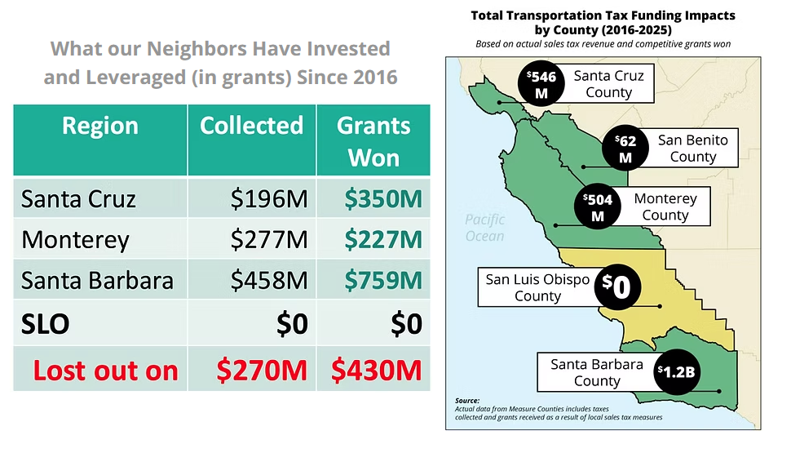
Impact of Sales Taxes on Winning Discretionary Grants
Most state and federal grant programs include local match criteria. Local sales taxes provide the primary source of local match in California.
Evidence from across California suggests that
for every $1 of transportation sales tax collected, an additional $1-2 dollars are awarded as grants.
Central Coast Example:
Sales Tax Collected and Grants Won (2016-2025)
Notes:
Local funding can unlock additional discretionary funding
Only 4% of projects applying for funding through the Active Transportation Program received awards, meaning projects effectively must have a local match to have a chance to score highly enough
SB 1: $5 billion annually, $200 million annually is reserved specifically for cities/counties with local transportation tax measures

Slide 55
Transportation Sales Tax 101
There are two types of local sales taxes, general and special. Any sales tax administered by YoloTD is a special tax by default.
In most cases, the county’s Transportation Authority approves an ordinance placing a tax measure on the ballot for a subsequent special election that year.
Once placed on the ballot, a local sales tax increase must be passed by voters to take effect. Special taxes must receive a 2/3 majority of votes to pass if introduced through a board-approved ordinance.*
Revenue is allocated based on an expenditure plan included in the associated ordinance.
Local transportation sales taxes usually include a Citizens Oversight Commission to ensure transparent and appropriate use of funds.
*Note: If placed on the ballot via citizen's initiative, 50% majority is required. More on this later.
Notes:
Any tax administered by YoloTD is a special tax, requiring a 2/3 majority of Yolo County voters to approve
An ordinance would include an expenditure plan detailing how revenue would be spent, usually on a yearly basis by category
A tax measure only requires a simple majority if it is placed on the ballot through a citizen's initiative rather than a board-approved ordinance

Slide 56
How are funds typically allocated?
The major categories included in existing local transportation sales tax measures in California:
Local streets and roads
Large capital projects
Transit operations
Active transportation can also be included as its own category or integrated into local streets and capital projects.
Transportation Authorities have flexibility to design their expenditure plans based on a combination of local priorities, funding needs, and political feasibility.
Notes:
Transportation Authorities have a lot of flexibility in how they choose to allocate funds in their expenditure plans
Most counties allocate funding to some combination of local streets and roads, large capital projects, and transit
Large capital projects are usually either chosen from a CTIP or are selected on a discretionary basis
Local streets and roads is often the largest expense, with some counties prioritizing larger regional projects and others choosing to use a larger portion of sales tax funding to fund transit operations
Active transportation

Slide 57
YOLO COUNTY SALES TAX CONSIDERATIONS

Slide 58
What could a measure fund in Yolo County?
Local streets and roads
Most existing transportation sales taxes return a portion of revenue to each jurisdiction for local streets and roads based on the share of revenue generated, population, road mileage, or some combination of the three.
Capital projects
There is significant flexibility in how capital project funds could be allocated. A Countywide Transportation Improvement Plan could form a foundation by collecting and prioritizing local projects. Other allocation methods could include jurisdictions self-identifying priority projects based on their own plans, or competitive project selection based on established evaluation criteria.
Transit
A portion of generated revenue could go directly to transit operations and/or capital expenses for YoloTD, or it could go to member jurisdictions for local streets and roads while current TDA funding used for that purpose is returned to the district.

Slide 59
How much revenue would be generated annually?
Jurisdiction | Existing Tax Rate | Taxable Transactions 2024 | Estimated Tax Revenue 2024 | Add’l Annual Revenue from Quarter Cent Increase | Add’l Annual Revenue from Half Cent Increase | Percent of Total Revenue
Yolo County Unincorporated | 7.25% | $627,284,353 | $45,478,116 | $1,568,211 | $3,136,422 | 9%
Davis | 9.25% | $1,005,685,375 | $93,025,897 | $2,514,213 | $5,028,427 | 19%
Woodland | 8.00% | $1,647,199,540 | $131,775,963 | $4,117,999 | $8,235,998 | 26%
West Sacramento | 9.25% | $2,376,360,934 | $219,813,386 | $5,940,902 | $11,881,805 | 44%
Winters | 8.25% | $105,850,134 | $8,732,636 | $264,625 | $529,251 | 2%
Total |  | $5,762,380,336 | $498,825,998 | $14,405,951 | $28,811,902 | 100%

Slide 60
Could Sales Tax Revenue Replace
TDA for Local Streets and Roads?
 | TDA Funds Retained in FY 24-25 | Add’l. Annual Revenue from Quarter Cent Increase (2024) | Remaining Revenue (Quarter Cent) | Add’l. Annual Revenue from Half Cent Increase (2024) | Remaining Revenue (Half Cent)
All Jurisdictions | $8,259,219 | $14,405,951 | $6,146,732 | $28,811,902 | $20,552,683
Yes!
A half cent tax would generate enough revenue in each jurisdiction to entirely replace TDA funds for local streets and roads, while also leaving an additional $20.5 million annually for additional investments such as capital projects, active transportation, increased transit or increased funding for local streets and roads.
A quarter cent tax would generate enough revenue to entirely replace TDA in some, but not all, Yolo County jurisdictions.

Slide 61
How would we decide which projects to fund?
Many counties prepare a Countywide Transportation Improvement Plan (CTIP) to guide expenditures.
A CTIP is a countywide plan that identifies priority transportation improvements across all modes. The CTIP often serves as the foundation for deciding which projects to include in an expenditure plan – particularly major capital projects.​ It would also be beneficial to YoloTD and the county at large as a planning document in its own right.​
A 2018 CTIP developed by YoloTD staff provides a compilation of needs and projects but lacks evaluation criteria and project prioritization. This plan identified a countywide sales tax as the most promising funding solution, but no further action was taken at the time.
Staff is currently exploring funding opportunities to develop an updated CTIP in FY 26-27. ​

Slide 62
POLITICAL CONSIDERATIONS

Slide 63
Does YoloTD have the authority to do this?
Yes!
YoloTD’s enabling legislation gives the district the direct authority to place a local transportation sales tax measure on the ballot through a board-approved ordinance.
A tax ordinance can be adopted if a majority of the board of directors and a majority of the governing bodies of YoloTD's member jurisdictions pass it. Once an ordinance is adopted, the measure can be placed on the ballot and must pass with a 2/3 majority.
Allowable uses include “the construction and improvement of state highways, the construction, maintenance, improvement, and operation of local streets, roads, and highways, and the construction, improvement, and operation of public transit systems.”
Tax measures may only be imposed for a maximum of 20 years, after which voters may reapprove the tax.
The tax rate can be between 0.25% and 1% in increments of 0.25%, and an expenditure plan must be included in the ordinance.

Slide 64
Haven’t Davis and West Sacramento already reached their sales tax caps?
Yes, but there are workarounds.
Of California’s 7.25% base state sales tax rate, 6% goes to the state and 1.25% goes to local cities and counties. Cities, counties, and special districts like YoloTD can impose additional taxes on top of this base rate up to a maximum of 2% for a combined local rate of 9.25%. Since Davis and West Sacramento already have city taxes of 2%, neither the county nor YoloTD can impose any additional tax without exceeding the limit.
Legislation could give YoloTD an exemption to the local sales tax cap. Several agencies have successfully passed legislation recently, giving themselves the ability to impose a new tax over the limit.
SB 333 (25-26 leg session) exempted the San Luis Obispo Council of Governments
AB 761 (25-26) exempted the Monterey-Salinas Transit District
SB 862 (23-24) exempted the Santa Cruz Metropolitan Transit District

Slide 65
What if some Yolo juridisctions aren’t a good fit?
We can design a measure to include only a subset of Yolo jurisdictions.
Language can be included in cap-exemption legislation that gives YoloTD the ability to impose a tax on only specific jurisdictions within the county.
A “coalition of the willing” could be created by only including jurisdictions that want to participate in the new tax.
AB 1223, passed in the 25-26 legislative session, gave the Sacramento Transportation Authority this power after several recent attempts to pass a local transportation sales tax in Sacramento County fell short. Future attempts can now exclude unincorporated areas of the county and specific cities.
AB 1413, passed in the 19-20 legislative session, gave the Placer, Solano, and San Diego Transportation Authorities this same ability.

Slide 66
Can we get 2/3 of voters to vote for it?
Maybe. But we could also consider other options.
A board-approved ordinance is not the only option for placing a transportation sales tax measure on the ballot.
A citizens’ initiative can place a measure on the ballot if it garners enough signatures in the county (approximately 6,900).
Sales tax measures placed on the ballot through the initiative process require a 50% + 1 majority to pass, unlike the 2/3 threshold of a traditional measure approved by the board.
In recent years, there have been attempts to subject citizens' initiatives to the same 2/3 vote requirement as ordinance-based measures. So far, these have been unsuccessful.

Slide 67
CASE STUDIES

Slide 68

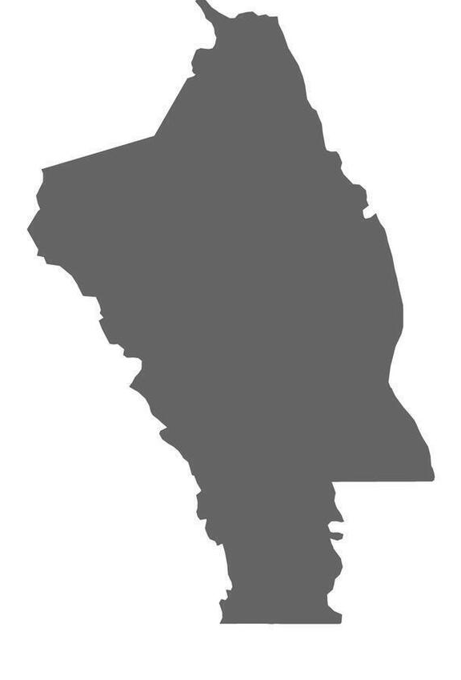
Measure U (2024): Political Considerations
NAPA COUNTY
Measure U was placed on the 2024 ballot through an ordinance by the Napa Valley Transportation Authority.
The tax was imposed at a rate of 0.5%, and did not require a legislative exception since no city in Napa had reached the 9.25% cap. ​
Measure U passed with 73% if the vote, well above the 66.7% majority needed. ​
The measure was a tax renewal of an existing transportation tax passed in 2012. Renewals are typically easier to pass than new taxes. ​
The measure garnered political support from a wide range of sources including the Napa Chamber of Commerce and several local newspapers. Informational materials emphasized road repair and improvement as well as traffic relief. ​
Notes:
Measure U replaced Measure T (2012) – also put almost all funding towards streets and roads but did not allow for bonding
Renewals are easier to pass
Political support from Chamber of Commerce

Slide 69
Measure U (2024): Expenditure Plan
NAPA COUNTY
The expenditure plan for Measure U is simple, with only two main funding categories. The plan includes a $56 million set-aside for capital projects, 2% of funds for administration, and all other revenue going to local streets and roads.
Local streets and roads funding is allocated based on the proportion of sales tax generated in each jurisdiction for the cities, with the county receiving funds based 50% on sales tax revenue generation and 50% based on the proportion of lane miles in the unincorporated area of the county. ​
The $56 million capital set-aside is to be used on a list of 4 primary highway projects listed in the expenditure plan. The projects included in this list are high scoring capital projects from the county’s Countywide Transportation Improvement Plan (CTIP). ​
100% of TDA funds in Napa go to transit, with Measure U providing significant funding for local streets and roads. ​
Notes:
Almost entirely for streets and roads
Formula allocates to jurisdictions based entirely on generated revenue for cities and on 50% generated tax revenue and 50% lane miles for the unincorporated parts of the county
Capital projects are based on CTIP
TDA funds go to transit, measure U provides streets and roads funding

Slide 70
Transportation Sales Tax Measure:
Qualitative Scoring and Potential Next Steps
REVENUE GENERATION POTENTIAL
POLITICAL FEASIBILITY
EASE OF IMPLEMENTATION
SALES TAX MEASURE
Low
Low
High
Potential Next Steps:
Interviews with peer agencies, experts, public opinion researchers to assess viability
Explore collaborations with other Yolo County agencies & stakeholders
Update 2018 Countywide Transportation Improvement Plan (CTIP)

Slide 71

Evaluating the Options
REVENUE GENERATION POTENTIAL
POLITICAL FEASIBILITY
EASE OF IMPLEMENTATION
High
INCREASED SHARE OF FEDERAL FUNDING
CONTINUED STATE TRANSIT RECOVERY (SB 125)
VMT MITIGATION
Medium
TOLL REVENUE FROM YOLO 80 PROJECT
INCREASE SHARE OF LTF FUNDING
Low
TRANSPORTATION SALES TAX MEASURE

Slide 72
Discussion and Next Steps
What clarifying questions do you have about these six options?
Are there other options you’d like us to explore?
Where would additional research/staff work be useful?
What are our next steps to continue this discussion?

Slide 73
Agenda Item 7
Administrative Reports
Board Member Reports
Executive Director’s Report
Transdev Report
Long Range Calendar

Slide 74
7d. Long Range Calendar
Mar 2026
Budget Workshop #2: Cost Allocation
Transit Operations RFP Update
Multi-Modal Program Overview
Yolo Commute Expansion Update
April 2026:
• Approve Transit Operations Contract
• Preliminary Workplan for FY 2026-27
May 2026:
FY 2026-27 Draft Budget and Workplan
Yolo Active Transportation Corridors (YATC): Draft Final Plan
Yolo Commute Program Expansion
SRTP Service Recommendations

