Slide 1
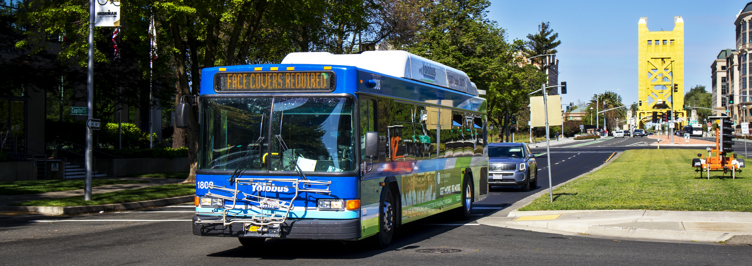
Board of Directors Meeting March 9, 2026
1

Slide 2
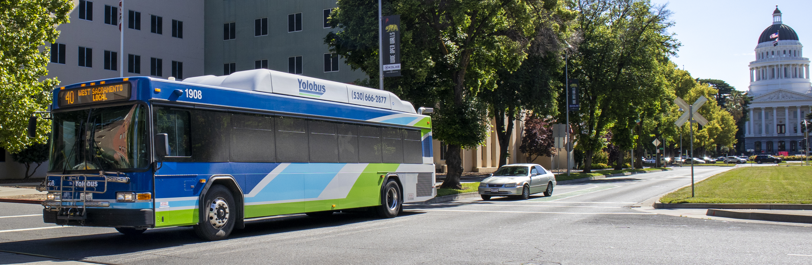
Agenda Item 1 : Call to Order/Roll Call Agenda Item 2: Closed Session Agenda Item 3: Approve Agenda for Mar 9, 2026, Meeting Agenda Item 4: Report Back from Closed Session Agenda Item 5: General Public Comments
2

Slide 3
CLOSED SESSION
The YoloTD Board of Directors is currently meeting in closed session, pursuant to pursuant to Gov. Code § 54956.9(d)(4).
The regular meeting is scheduled to resume at 6:30 pm.

Slide 4
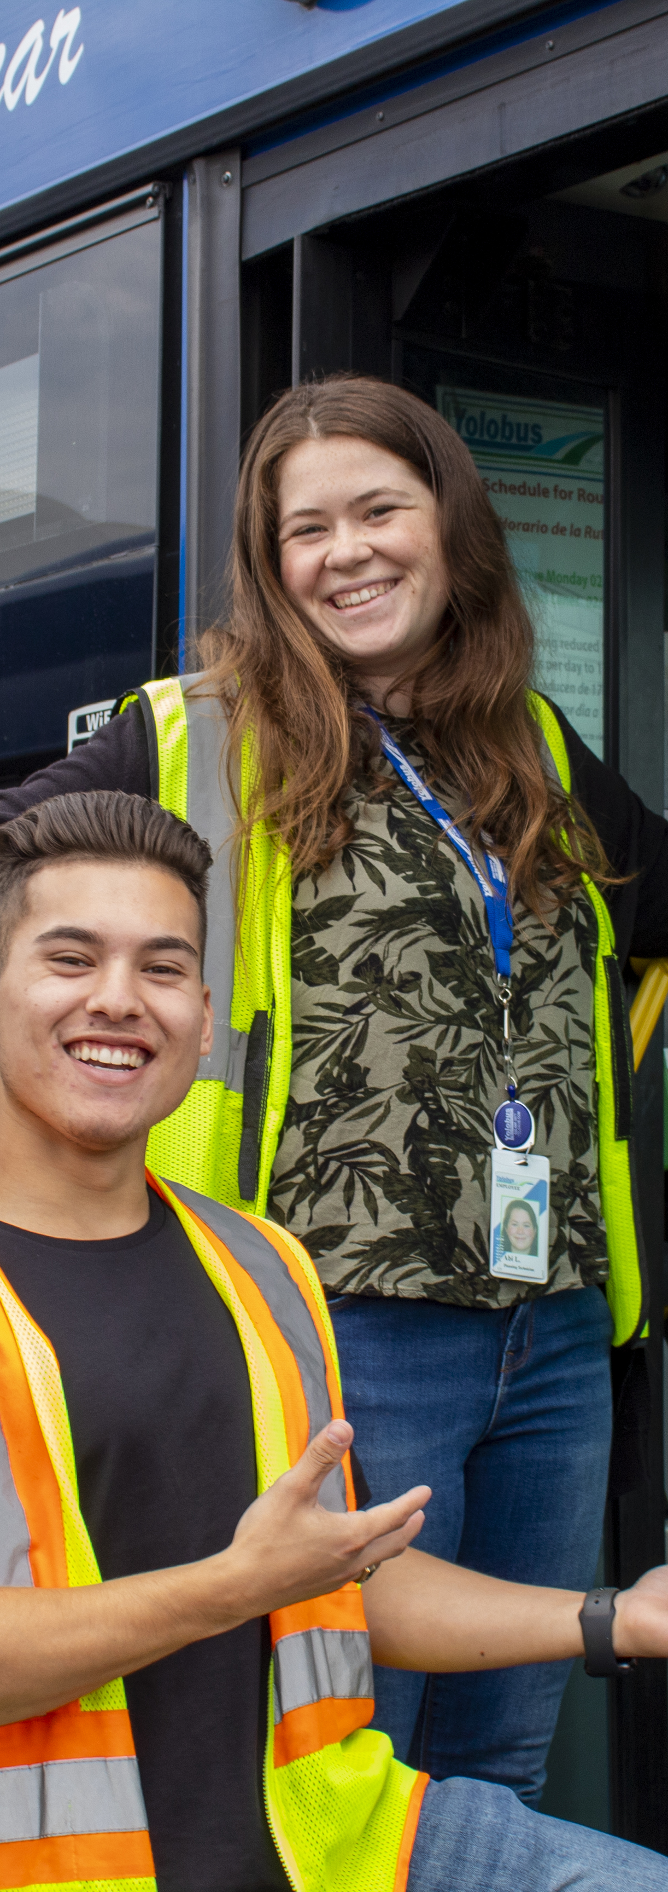
Agenda Item 4
Consent Calendar
6a | Approve Board Minutes for Regular Meeting of Feb 9, 2026
6b. | Adopt Amended Resolution 2026-03 to Accept Funding from Affordable Housing and Sustainable Communities Grant
6c | Ratification of Emergency Purchase of Property Insurance Coverage and Brokerage Services
6d | Approve Resolution 2026-04 Authorizing Programming of State of Good Repair Funding for Purchase of Used CNG Vehicles and Maintenance of the Yolobus Fleet and Facility

Slide 5
Budget Workshop #3 Operating Budget Cost Allocation

Slide 6
Budget Workshop Op & Cap Cost Allocation #3
1. Recap of Transit Funding Sources Workshop #1
2. Operating Budget Structure
3. Budget Development Process
4. Use and Allocation of Funding Sources
5. Status of Unrestricted Funds and Capital Reserves
6. Post-COVID Historical Financial Data
7. Future Impacts on the Operating Budget

Slide 7
1. Recap of Transit Funding Sources Workshop #1

Slide 8


Recap of Workshop #1 – Transit Funding Sources
STATE FUNDING – TRANSPORTATION DEVELOPMENT ACT (TDA)
0.25% Sales Tax on Goods
% of YoloTD Revenue
Local Transportation Funds (LTF)
34.5%
7.625% Sales Tax on Diesel Fuel
State Transit Assistance (STA)
10.5%

Slide 9
Recap of Workshop #1 – Transit Funding Sources
FEDERAL TRANSIT ASSISTANCE (FTA)- FORMULA FUNDS
% of YoloTD Revenue
5307 Urbanized Area
More than 200K Large
Sacramento
5.6%
Woodland
13%
5307 Urbanized Area
Less than 200K Small
Davis
0.7%
5311 Rural Area
Less than 50K
Yolo County
1%

Slide 10
2. Operating Budget Structure

Slide 11
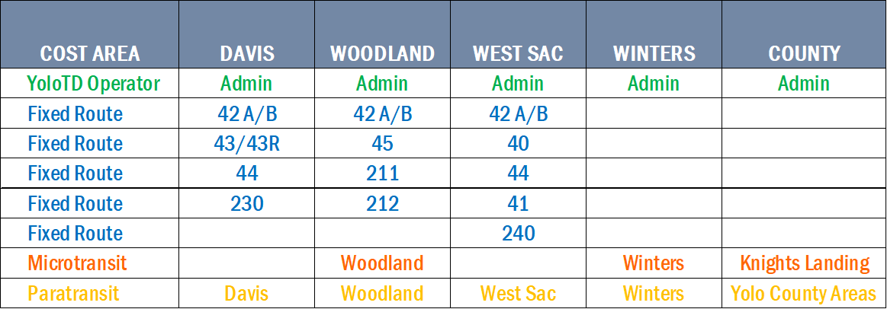
Operating Budget Structure
SERVICES BY JURISDICTION

Slide 12
Operating Budget Structure
COST AREAS & MAJOR COSTS
COST AREA | % OF BUDGET | #1 COST | #2 COST | #3 COST
Administration | 17% | Personnel (Sal & Ben) | Professional Services | Utilities
Fixed Route | 59% | Contracted Transportation | Insurance | Fuel
Microtransit | 10% | Contracted Transportation | Insurance | Fuel
Paratransit | 14% | Contracted Transportation | Insurance | Fuel
Multimodal | Op/Cap | Local Match: Professional Services | Local Match: Staff Time | N/A

Slide 13
Operating Budget Structure
ALLOCATION OF OPERATING EXPENSES BY JURISDICTION – FY25-26 EXAMPLE
*Other- Systemwide revenues that support the YoloTD transit system as a whole or not allocated to one specific jurisdiction.

Slide 14
3. Budget Development Process

Slide 15






Budget Development Process
ADMINISTRATION: PERSONNEL BUDGET
Position Review
Salary
Projections
Benefits & Taxes
CPI
Review
COLA
Calc
Budget Finalization
JAN-FEB
FEB
FEB - MAR
MAR
APRIL
MAY - JUNE
Review salary scales for
15 FTES
and
Part-time
staff
Review potential step increase.
Update health, dental, OPEB, pension & ER taxes.
Track Inflation trends to project potential salary changes.
Apply COLA
based on April CPI.
Minimum 2%
Maximum 4%
Finalize personnel budget as approved by Board.

Slide 16


Budget Development Process
ADMINISTRATION: OTHER MAJOR COSTS
Legal Counsel | Audit & Actuarial Services
Human Resources Support | IT Support
Facilities Maintenance | Marketing & Communications
Pest Control | Janitorial Services
PROFESSIONAL SERVICES
Landlines/Cell Phones | Water/Sewer
Electricity/Gas | Internet
Garbage | Security Systems
UTILITIES

Slide 17
Budget Development Process
TRANSIT SERVICE COST DEVELOPMENT PROCESS
ESTABLISH SERVICES
SERVICE COST UNITS
SERVICE COSTS
FIXED ROUTE
Routes
Days
Times
MICROTRANSIT
Service Areas
Days
Times
PARATRANSIT
Routes
Days
Times
FIXED ROUTE
Billable Hours
Billable Miles
Number of Vehicles
MICROTRANSIT
Revenue Hours
Number of Vehicles
PARATRANSIT
Billable Hours
Number of Vehicles
FIXED ROUTE
Hourly rate
Per Mile rate
Fixed Fee
Fuel, Insurance & Maint, etc.
MICROTRANSIT
Hourly rate
Fuel, Insurance & Maint, etc.
PARATRANSIT
Hourly rate
Fixed Fee
Fuel, Insurance & Maint, etc.

Slide 18
Budget Development Process
FIXED ROUTE: CONTRACTED TRANSPORTATION - EXAMPLE
# Hours
# Miles
# Days
Annual Fixed Fee
Contracted Transportation
Weekdays Only*
Contractor
Annual Cost
Start to End
Rev & DH*
Stop to Stop
Rev & DH*
Woodland
Route 211
$319,657
Weekdays
5:52A – 9:00P
13.09 x 15 Trips
5 Days x 50.2 Weeks
$2,877,533 per Year
15.9 per Day
196.35 per Day
251 Days per Year
3,990 Route Hrs/ 148,188 Total Hrs
$48.64 Hour
$0.99 Mile
($773 + $194) x 251 Days
2.7% of Total FR Hrs
$773 per Day
$194 per Day
$242,717 per Year
$77,693 per Year
* DH = Dead Head time is when the bus is operating without carrying passengers while moving between locations needed to begin or end the service.
* To simplify the example, the calculation includes weekday service only. Woodland Route 211 also includes weekend service.

Slide 19
FIXED ROUTE: OTHER TRANSIT COSTS
Budget Development Process
Cost | Cost Drivers
Insurance (CalTIP) | Fleet size/value, claims history, vehicle age and pool rate changes
Fuel & Charging | Market prices, electricity rates & demand charges, service miles and fleet service mix
Fleet & Facilities Maintenance | Aging buses, parts & labor costs, preventative maintenance cycles, and facility/shop upkeep
Technology | Onboard systems, software licenses, data plans, hardware replacement
Services | Security service hours, transit planning service changes, number of vehicles for radio & communications and outreach/advertising for service changes
Contingency | Emergency repairs, major breakdowns, fuel/utility spikes, and regulatory changes

Slide 20
Budget Development Process
MICROTRANSIT: CONTRACTED TRANSPORTATION - EXAMPLE
# Hours
# Days
# of Vehicles
Annual Fixed Fee
Contracted Transportation
Mon-Thurs Only*
Mon-Thurs Only*
Current Contract
None
Annual Cost
Start to End
7:00A – 7:00P
4 Days x 50.2 Weeks
$0
Winters
$281,200
Mon-Thurs
2
12 per Day
200.8 Days per Yr
2
$0
$58.35 Hour
$700 x 200.8
$140,600 x 2
$0
$700 per Day
$140,600 per Yr
$281,200 per Year
$0
* To simplify the example, the calculation includes Winters’s Mon-Thurs service only. Winters Microtransit also includes weekend service.

Slide 21
MICROTRANSIT: OTHER TRANSIT COSTS
Budget Development Process
Cost | Cost Drivers
Insurance (CalTIP) | Fleet size/value, claims history, vehicle age and pool rate changes
Fuel | Market prices and service demands
Fleet & Facilities Maintenance | Aging buses, parts & labor costs, preventative maintenance cycles, and facility/shop upkeep
Technology | Onboard systems, software licenses, data plans and hardware replacement
Services | Transit planning service changes, number of vehicles for radio & communications and outreach/advertising for service changes
Contingency | Emergency repairs, major breakdowns, fuel/utility spikes, and regulatory changes

Slide 22
Budget Development Process
PARATRANSIT: CONTRACTED TRANSPORTATION - EXAMPLE
# of Trips
# Hours
Annual Fixed Fee
Contracted Transportation
Start Origin City
Contractor
Annual Cost
Start Origin City
Review PY Trips
Review PY & CY Hrs
$358,344 per Yr
Davis
$526,458
454 Avg per Month
1 Hour Avg per Trip
5,444 Davis PT Hrs
24,699 Total PT Hrs
= 22%
5,444 per Yr
5,444 Hrs per Yr
Review Avg Time per Trip
5,444 x $82.20 Hourly Rate
$358,344 x 22% Davis
$447,474 per Yr
$78,984 per Yr
PY = Prior Year CY= Current Year

Slide 23
PARATRANSIT: OTHER TRANSIT COSTS
Budget Development Process
Cost | Cost Drivers
Insurance (CalTIP) | Fleet size/value, claims history, vehicle age and pool rate changes
Fuel | Market prices and service demands
Fleet & Facilities Maintenance | Aging buses, parts & labor costs, preventative maintenance cycles, and facility/shop upkeep
Technology | Onboard systems, software licenses, data plans and hardware replacement
Services | Transit planning service changes, number of vehicles for radio & communications and outreach/advertising for service changes
Contingency | Emergency repairs, major breakdowns, fuel/utility spikes, and regulatory changes

Slide 24
4. Use and Allocation of Funding Sources

Slide 25
Use and Allocation of Funding Sources
YOLOTD FUNDING SOURCES
SPECIFIC PURPOSE
MORE FLEXIBLE

Slide 26
Use and Allocation of Funding Sources
ELIGIBLE USES AND ORDER OF FUNDING

Slide 27
Use and Allocation of Funding Sources
FUNDING PRIORITY ORDER BY JURISDICTION – OPERATING BUDGET
*Other- Systemwide revenues that support the YoloTD transit system as a whole or not allocated to one specific jurisdiction.

Slide 28
Use and Allocation of Funding Sources
ADMINISTRATION FUNDING ALLOCATION:

Slide 29
5. Status of Unrestricted Funds and Capital Reserves

Slide 30
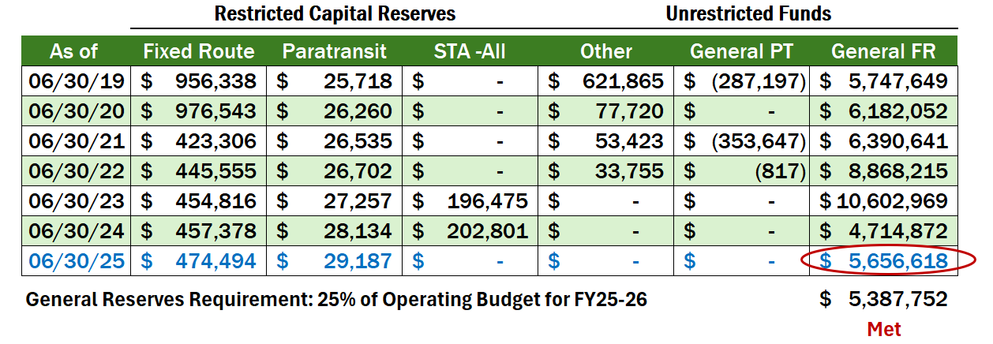
Status of Unrestricted Funds and Reserves

Slide 31
6. Post-COVID Historical Financial Data

Slide 32
Post-COVID Historical Financial Data
Notes:
Will add more context about the significant changes.

Slide 33
7. Future Impacts on the Operating Budget

Slide 34
Future Impacts on Operating Budget

Slide 35
Questions?

Slide 36
INFORMATIONAL UPDATE ON RFP FOR TRANSPORTATION SERVICES
Agenda Item 8

Slide 37
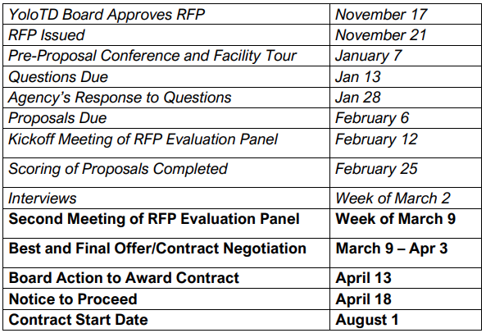
Timeline for New Contract

Slide 38
Recent Milestones
Pre-Proposal Conference
30+ people representing six firms attended
Proposals Submitted
Four proposals were submitted, deemed complete and scored.
Interviews
Evaluation panel interviewed all four proposers

Slide 39
Next Steps
Best and Final Offer(s)
Updated cost proposals from highest-scoring proposers due next week
Checking References
Public agencies who are current clients
Contract Negotiation
Finalizing terms and conditions

Slide 40
Observations and Themes
Technology Tools
Tech-driven innovation across all aspects of transit operations
Liability / Risk Management
Broad changes in insurance market are driving cost uncertainty
Industry Consolidation and Disruption
A small number of large firms now dominate the industry, with smaller disrupters looking to gain market share

Slide 41
Agenda Item 9
Administrative Reports
Board Member Reports
Executive Director’s Report
Transdev Report
Long Range Calendar

Slide 42
9d. Long Range Calendar
April 2026:
• Approve Transit Operations Contract
• Multimodal Program Overview
• Yolo Commute Program Expansion - Discussion
• Preliminary Workplan for FY 2026-27
May 2026:
• FY 2026-27 Budget and Workplan – Discussion
• Yolo Active Transportation Corridors (YATC): Draft Final Plan
• Yolo Commute Program Expansion – Action
June 2026:
FY 2026-27 Budget and Workplan – Adoption
Approve MOU for Sacramento UZA
SRTP Service Level Recommendations

