Slide 1
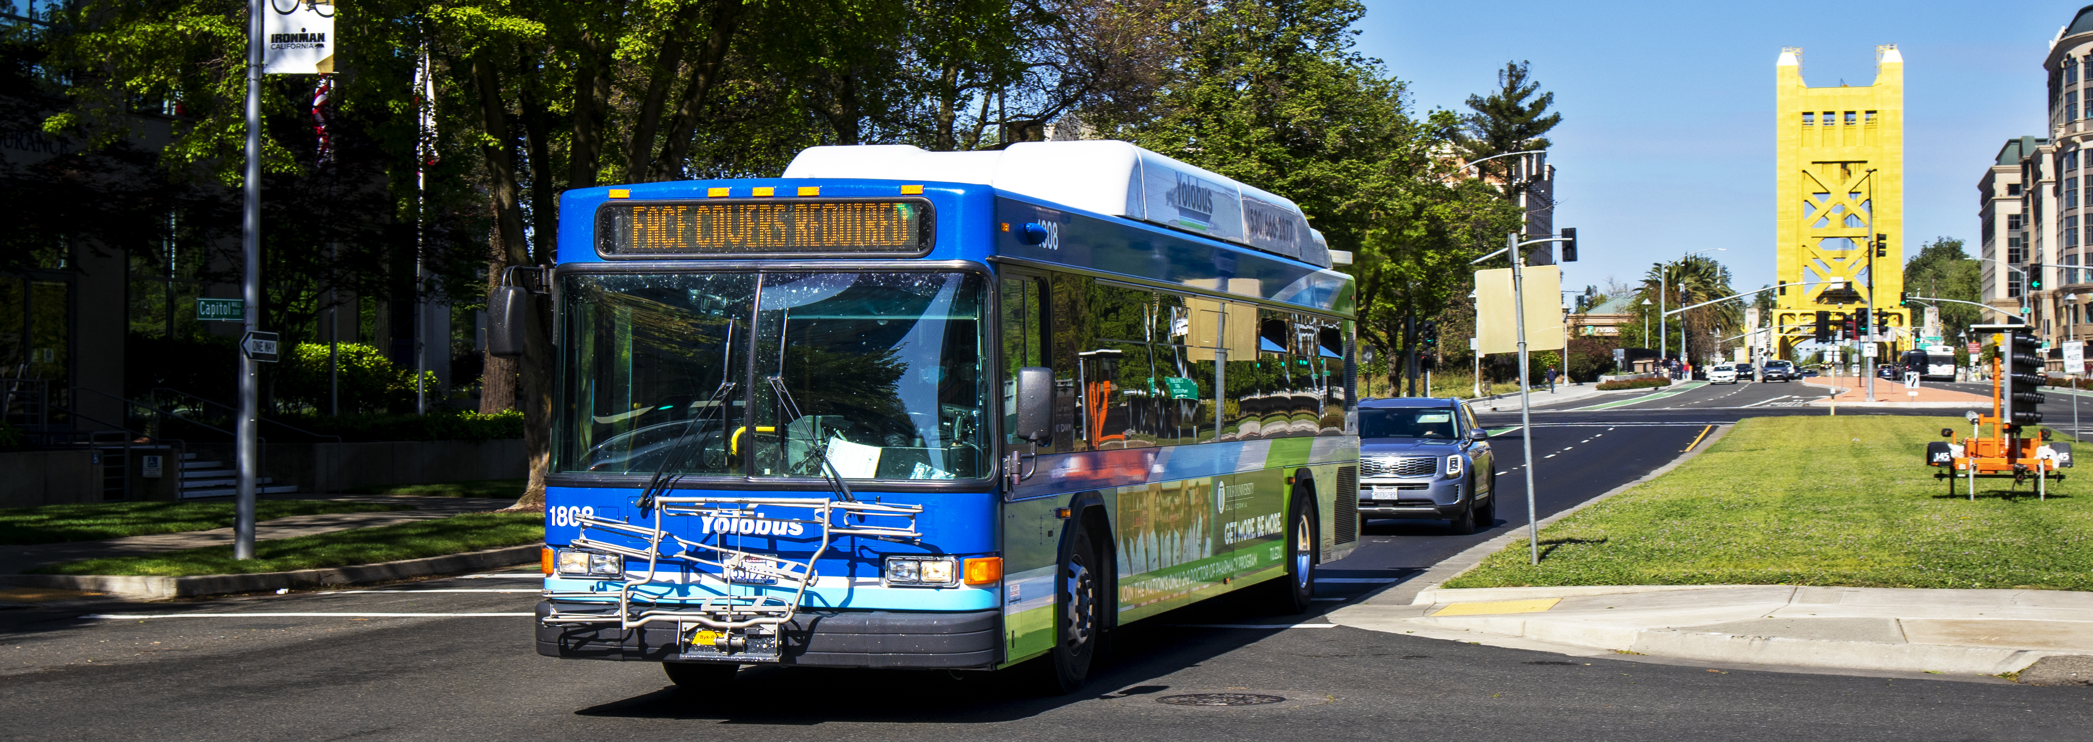
Board of Directors Meeting April 13, 2026
1

Slide 2
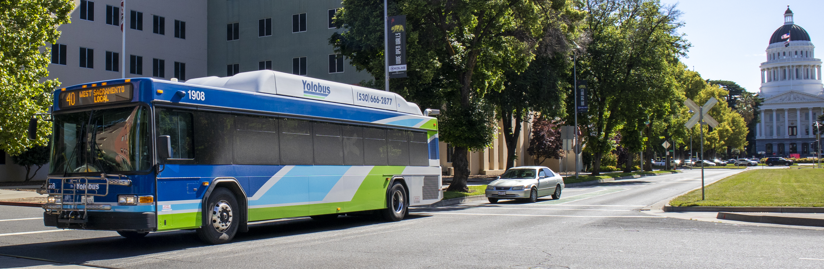
Agenda Item 1 : Call to Order/Roll Call Agenda Item 2: Approve Agenda for Apr 13, 2026, Meeting Agenda Item 3: General Public Comments
2

Slide 3
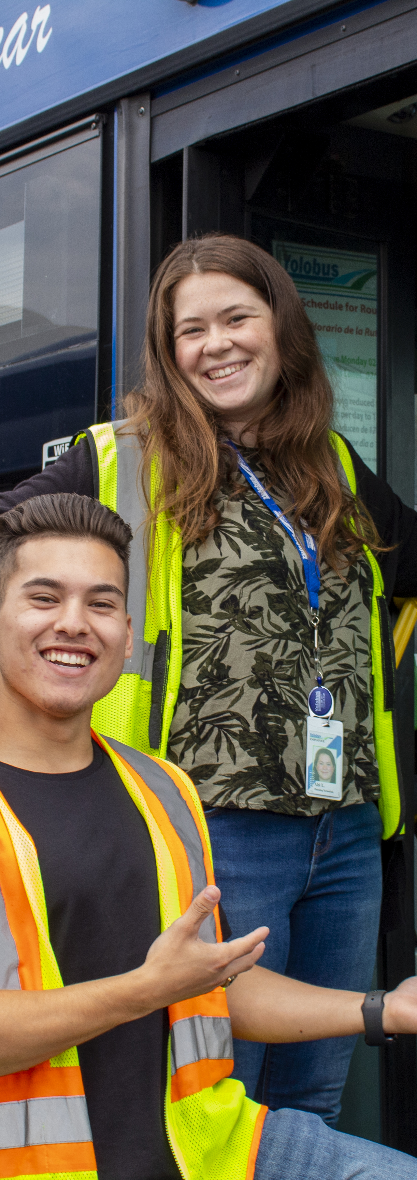
Agenda Item 4
Consent Calendar
4a. | Approve Board Minutes for Regular Meeting of Mar 9, 2026
4b. | Approve Resolution 2026-05 Authorizing Executive Director to Enter into Agreements for On-Call Consulting Bench with Alta Planning + Design, Inc., GHD, Inc., and Kimley-Horn, Inc. for an amount not to exceed $5 Million
4c. | Approval of Updated Procedures for Remote Meeting Participation to Reflect Recent Brown Act Amendments (SB 707)

Slide 4
Item 5 Transit Operations Contract Award

Slide 5
Background
Procurement of a new Transit Operations Contract is one of the YoloTD's most consequential decisions. This contract makes up more than 70% of the annual budget and is core to how YoloTD provides transit service to the county.
YoloTD staff, expert consultants, and an evaluation panel with decades of transit operations experience all contributed to the months long process of developing a new RFP and evaluating proposals.

Slide 6
Contract RFP Timeline
Proposals Due
Scoring of Proposals Completed
Evaluation Panel Meets to Discuss Interviews, Request BAFOS
Evaluation Panel Reviews BAFOs, Votes on Recommendation
YoloTD Board Action to Award Contract
Contract Negotiations
NOV
DEC
JAN
FEB
MAR
APR
MAY
JUN
JUL
AUG
Transition/Startup Period
RFP Released
Pre-Proposal Conference and Facility Tour
Evaluation Panel Kickoff
Interviews
Best and Final Offer Period and Reference Checks
Meeting with Woodland, Winters, and Yolo County
Full Service Turnover

Slide 7
Roles and Responsibilities
Staff and Consultants
Evaluation Panel
Executive Director Autumn Bernstein led this process along with Director of Transit Operations Daisy Romero.
Advising and Analysis from CapitalGCS
Rick Ramacier
Milo Victoria
Kevin Faulkner
Legal Advice from Hanson-Bridgett
Julie Sherman
Nicole Witt
Evaluation panels reviewed and scored proposals, participated in interviews, and ultimately made a recommendation for contract award.
Panelists:
Ryan Chapman, City of Davis
Matthew Mauk, Yuba-Sutter Transit
Jeff Flynn, Unitrans
Jason McCoy, City of West Sacramento
Autumn Bernstein and Daisy Romero, YoloTD
Kristina Svensk, SACOG
Lisa Baker, CAC (non-voting)

Slide 8
Evaluation Criteria
Proposal Evaluation Criteria:
Qualifications and Experience of the Firm
Thoroughness and Comprehensiveness of the Proposer’s Understanding and Approach to the Project
Qualifications and Competence of Key Personnel
Clarity and Reasonableness of Price Proposal
Retention and Recruitment of Qualified Workforce
Creative/Innovative Solutions for Maximizing Service and Efficiency

Slide 9
Evaluation Panel Review of Proposals
YoloTD received 4 proposals from Transdev, MV Transportation, RATP-Dev, and Via
Panelists reviewed proposals and decided to interview all 4 firms
After interviews, panelists agreed to request Best and Final Offers from MV, Transdev, and Via
Staff performed reference checks and reported findings back to the panel
After reviewing the Best and Final Offers, the panel came to a unanimous decision

Slide 10
Summary of Proposer Evaluation Pre-Interview
Proposer | Pre-Interview Average Score
Via | 73.7
Transdev | 78.8
RATP-Dev | 78.1
MV Transportation | 84.2

Slide 11
Summary of Proposer Evaluation Post-Interview
Proposer | Post-Interview Average Score
Via | 77.9
Transdev | 72.3
RATP-Dev | 69.3
MV Transportation | 85.9

Slide 12
Best and Final Offers
Proposer | Fiscal Year | Pricing (Base Year) | Percentage Increase
Transdev (Current) | FY 25-26 | $13,059,902 | -
Transdev (Proposed) | FY 26-27 | $15,625,864.47 | 19.6%
RATP-Dev | FY 26-27 | $15,291,212.59 | 17.1%
MV Transportation | FY 26-27 | $15,291,921.40 | 17.1%
Via | FY 26-27 | $13,552,977.20 | 3.8%

Slide 13
Evaluation Panel Decision
After reviewing the BAFOs from MV, Via, and Transdev, and reviewing staff's the evaluation panel unanimously agreed to recommend to award YoloTD's new Transit Operations Contract to MV Transportation, Inc.
Panelists agreed that MV's proposal was the strongest due to several factors:
Significant operator wage increases
Increased staffing levels for operators, road supervisors, and a dedicated accounts manager
Technology improvements, including in fleet management, KPI visibility, and safety
A strong and experienced local management team

Slide 14
Protections for Yolobus Frontline Workers
MV Transportation agreed to honor the existing Collective Bargaining Agreement with the Amalgamated Transit Union
MV will rehire all unionized employees for a period of 90 days after they take over service
Improvements to run-cutting will also provide benefits to Yolobus workers, allowing for better shifts for operators to reduce spread-time

Slide 15
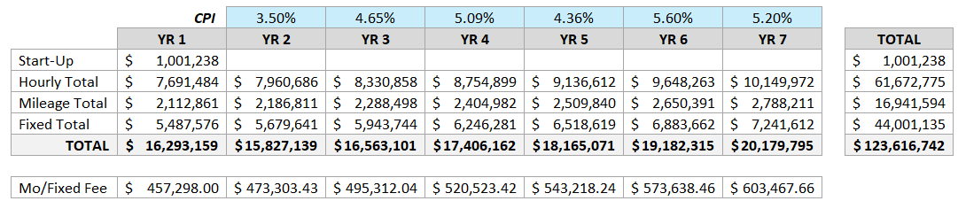
Proposed Contract Costs (at current service levels)

Slide 16
One-Time Startup Costs
Payment Date | Pro-Rated Startup Payment
April 30, 2026 | $130,079
May 31, 2026 | $130,079
June 30, 2026 | $130,079
July 31, 2026 | $116,000
August 31, 2026 | $45,000
September 30, 2026 | $45,000
October 31, 2026 | $45,000
November 30, 2026 | $45,000
December 31, 2026 | $45,000
January 31, 2027 | $45,000
February 28, 2027 | $45,000
March 31, 2027 | $45,000
April 30, 2027 | $45,000
May 31, 2027 | $45,000
June 30, 2027 | $45,000
MV Transportation included a one-time startup cost of $1,001,238 in their Best and Final Offer
To absorb this unexpected near-term cost, staff recommends a one-time drawdown from YoloTD's reserves totaling $390,273 in FY 2025-26, with the remaining balance paid monthly in FY 2026-27.

Slide 17
Fiscal Impact
Fixed costs will stay consistent, but variable costs can change depending on the level of service provided
The Price Proposal Template required all Proposers to provide costs for a range of different transit service levels, from 60% of current service levels to 140% of service levels.
YoloTD's nearly-complete SRTP includes reduced 80% and 90% scenarios, as well as a base level scenario and an optimistic 110% scenario.
In the event that it becomes necessary to reduce transit service, the SRTP’s reduced-service scenarios will provide the roadmap for those service cuts.

Slide 18
STAFF RECOMMENDATION(S)
•Award of a contract to MV Transportation to provide Purchased Transportation Services for a three-year term, with up to two option years, for a total amount not to exceed $123,616,742.
• Authorize Executive Director to execute the attached purchased contract agreement with MV Transportation.
• Authorize a one-time drawdown of up to $390,237 from YoloTD’s Operating Reserve to pay contract startup costs that were not anticipated in the Board-approved budget for the current fiscal year (FY 2025-26).

Slide 19

Agenda Item 6 Share feedback on expanding Yolo Commute to meet VMT reduction commitments for the Yolo 80 Managed Lanes Project

Slide 20
What is Yolo Commute?

Slide 21

YOLO COMMUTE / TMA
Yolo County’s
Transportation Demand Management Organization!
MISSION:
Our mission is to reduce single-occupant (drive alone) commutes throughout Yolo County Yolo TMA Incorporated in 1994 as 501 (c)(4)
Existing TDM Program
Yolo Commute manages a membership-based TDM program for employers in Yolo county

Slide 22
Why Expand Yolo Commute? Yolo 80 EIR VMT Mitigation

Slide 23

Yolo 80 Mitigation Funding for Yolo Commute Expansion
Yolo Commute Expansion = 1 of 7 Yolo 80 EIR Mitigation Measures
Yolo 80 Capital Project Phase 1: $5.2M for four years to Yolo Commute Expansion ($1.3M/year)
Toll revenues assumed to continue funding thereafter

Slide 24
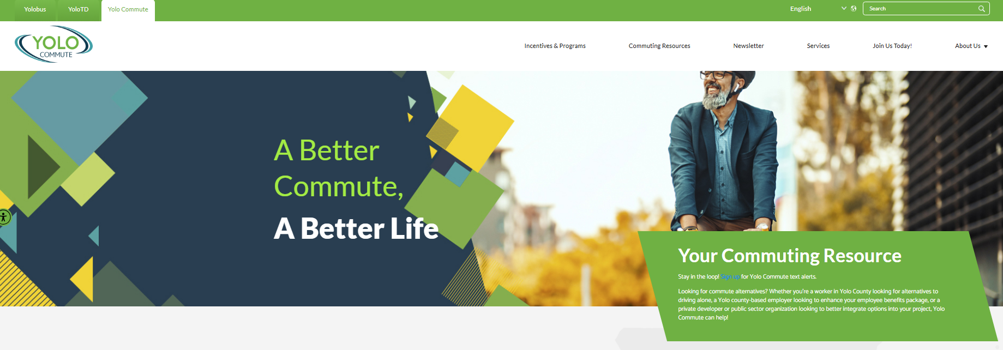
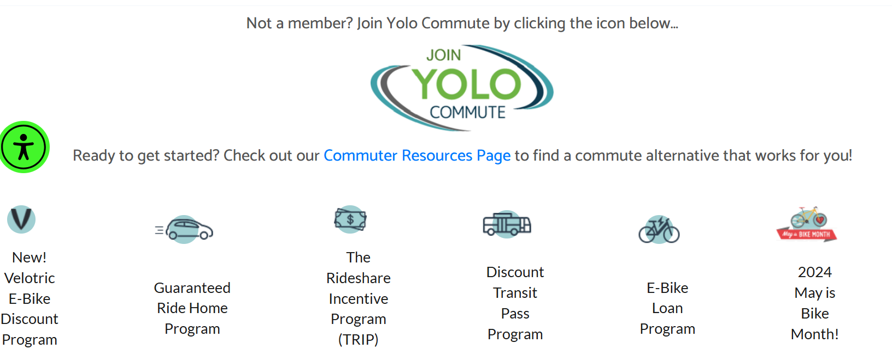
TDM Program & Organizational Study
Purpose:
To reduce vehicle miles traveled increases from Yolo 80 project, funded by capital project and toll revenue
Goal:
Develop an expanded TDM program that:
Fulfills EIR requirements
Complements current Yolo Commute priorities
Identifies improved organizational model to operate the program

Slide 25
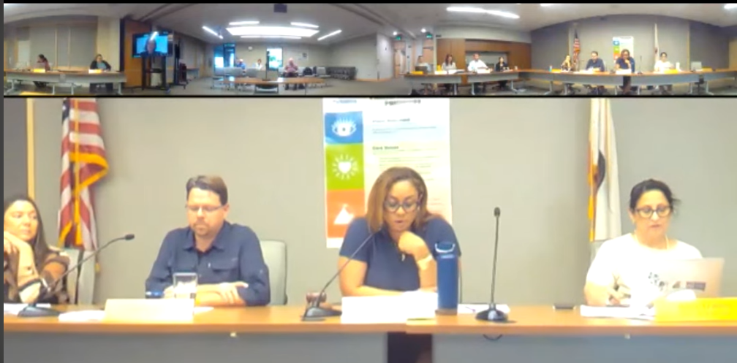
September 8, 2025 Board Update
Overview of Yolo Commute history, administration, programs, and accomplishments
TDM program expansion framework assumptions
Organizational structure options
Next steps
Notes:
Source: About Us | Yolo Commute

Slide 26
Agenda
TDM Program Assumptions
Organizational Model Options & Recommendation
Connecting the Dots
& Next Steps

Slide 27
TDM Program Assumptions
Overview

Slide 28
TDM Program Elements
 | TDM Categories
TDM Services | County-wide Programs | Employer Programs | Residential & School | Education & Outreach
Commute Information | Mode options & equity NorCal Go registration Carpool, vanpool & biking | Commuter benefits ordinance Employer toolkit | Safe Routes to School UC Davis & Woodland CC Zoning requirements | Biking, telework & walking tips Carpool/vanpool
Commuter Programs | Bike programs / incentives Guaranteed Ride Home Discounted transit passes Carpool/vanpool incentives | — | — | —
Consulting Services | — | Alt. work arrangements Surveys & heat mapping On-site events & seminars Benefit law guidance | Travel training SRTS audits & surveys Property manager training Custom commute materials | —
Broader Programs | Yolobus access & training Yolo 80 Equity Program Capitol Corridor / Lyft First/last mile connections | — | — | Marketing/Comms Translations support Commuter newsletter Social media & events

Slide 29
Implementation Timeline
1
Phase 1 (3yrs) - Foundation
3
Phase 3 (3yrs) - Full Scale
FY 2027–28 Operational on Day 1
Launch core countywide and employer programs.
Establish governance under YoloTD.
Begin TDM Program transition.
FY 2035–36 Operational beginning Year 8
Complete program portfolio operations.
Full staffing complement reached and all additional FTEs in place.
2
Phase 2 (4yrs) - Expansion
FY 2031–32 Operational beginning Year 4
Add residential, school, and enhanced outreach programs.
Grow staffing and partner coordination capacity.

Slide 30
All Phases – Staffing Needs
Business Services
Phase 1 Resources (2027-28):
~2 FTEs for TDM, Outreach, Comms
~1.5 FTEs for Web Design
Leadership
~1.5
Total TDM Program Staffing Needs:
9 FTE Equivalent by Phase 3 (FY 2035-36)

Slide 31
Organizational Model Options & Recommendation

Slide 32
Model Assessment Process
We Are Here
Establish key inputs
Propose cost inputs vs staffing
Develop models
Gain alignment from YoloTD leadership on models and vet assumptions
Capture the relative impacts of the models and recommend preferred model
Timeline implementation
Adjusting # FTEs
Available funding
Shared services
Yolo Commute
Board Feedback March 2026

Slide 33
Organizational Elements
Program
Administration
TDM Program delivery oversight and compliance. This should be a public entity.
Program
Delivery
Direct TDM Program delivery, management, and operations. This can be a public or private entity.
Business
Services
Procurement, HR, Payroll, invoicing and other functions.

Slide 34
Models Assessed
 | YoloTD Oversight + Partner Agreements | YoloTD TDM Program Division / Team | Independent TDM Organization
 | YoloTD is responsible for program administration, key partners deliver the program | YoloTD establish a dedicated business division / team in-house to deliver the countywide TDM program | All functions performed by a legally separate, independent TDM organization
Program Governance & Funding Accountability | YoloTD Board | YoloTD Board | Independent Agency Board
Program Administration | YoloTD | YoloTD | Independent Agency
Program Delivery | Contract partners deliver programs; YoloTD oversees all contracts | YoloTD TDM staff deliver programs | Independent Agency
Business Services | YoloTD provides business functions; program pays for costs per contract | YoloTD provides business functions; program pays for costs | Independent Agency
A
B
C

Slide 35


Benefits and Limitations
 | YoloTD Oversight + Partner Agreements | YoloTD TDM Program Division / Team | Independent TDM Organization
Benefits | Preserves employer‑market agility Cost‑effective ramp via partner agreements Leverages on‑the‑ground relationships | Clear public accountability and consistent program delivery Builds long-term in-house capability Strong alignment with CARTA VMT policy Easier integration of equity requirements | Potential for more flexible service delivery High market agility & strong employer relationships Brand refresh, especially with expanding program
Limitations | Requires robust oversight & performance‑based IGAs Significant countywide coordination Potential entity ambiguity if roles unclear | Business services downstream impacts Larger up-front effort needed for staff capacity to meet program needs Slower employer-market agility vs. contracted programs | Cost and level of investment in business needs and staff capacity Must harden public-fund governance (procurement, audit, compliance) to meet countywide standards
A
B
C

Slide 36
Preferred Model
A & B
$$$
$$$
 | YoloTD Oversight + Partner Agreements | YoloTD TDM Program Division / Team | Independent TDM Organization
 | YoloTD is responsible for program administration, key partners deliver the program | YoloTD establish a dedicated business division / team in-house to deliver the countywide TDM program | All functions performed by a legally separate, independent TDM organization
Program Governance & Funding Accountability | YoloTD Board | YoloTD Board | Independent Agency Board
Program Administration | YoloTD | YoloTD | Independent Agency
Program Delivery | Contract partners deliver programs; YoloTD oversees all contracts | YoloTD TDM staff deliver programs | Independent Agency
Business Services | YoloTD provides business functions; program pays for costs per contract | YoloTD provides business functions; program pays for costs | Independent Agency

Slide 37
Cost Considerations
YoloTD / Yolo County Job Classifications (Salaries)
Program-specific Operational Costs
Labor is the primary cost driver.
Overall costs are similar whether delivered by YoloTD staff, partner agencies, or contractors.
YoloTD retains flexibility to decide in-house vs. contracted delivery for each role as the program matures.
The phased model allows cost to scale incrementally – YoloTD is not committing to full staffing on Day 1.
Estimated FTEs (By Phase)
Fringe Rates
Cost Model
Forecasted Program Costs

Slide 38
Phase 1 Program Costs (2027 – 2030)
Ramp Up Start: May 14, 2027 | Operations Start: July 1, 2027 | Values in $ thousands
$1,150k
$1,180k
$1,210k
Total Phase 1 Cost:
$3,740k

Slide 39
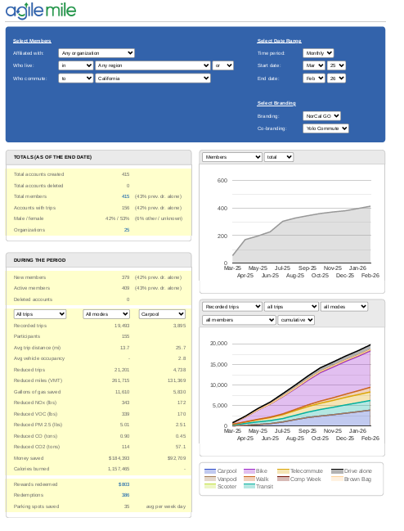

Program Success Metrics
Track monthly engagement (web traffic, events, calls, social media)
Monitor monthly registrations and employer sign‑ups
Report annually on program reach (touchpoints) and planned vs. actual activities
Track TDM budget vs. quarterly spend and cost per participant
Use back-end analytics
Countywide household travel survey (mode share, VMT, fleet composition)

Slide 40
Connecting the Dots
Organizational design, governance, and staffing needs aligned with each phase of the TDM Program.
Integrated framework ensures YoloTD has the responsibility, partner support, and flexible capacity to deliver the program across Yolo County.
Preferred Org Model
YoloTD shifts to full program delivery, consolidating decision-making, leverage key partners.
TDM Program
Staffing Plan
Includes 4 program categories - scaled in three phases.
Ramped to match program growth and capacity as staffing grows.

Slide 41
Next Steps

Slide 42
Next Steps
Present to YoloTD Board on April 13 ◄ TODAY
Incorporate Board feedback
Planned YoloTD Board action on May 18
Memorialize recommendation and finalize implementation roadmap
Final memo/report

Slide 43
Thank you!
Any questions?
Andrew.Strumolo@wsp.com
Eryca.Dinsdale@wsp.com

Slide 44
Agenda Item 7
Administrative Reports
Board Member Reports
Executive Director’s Report
Transdev Report
Long Range Calendar

Slide 45
7d. Long Range Calendar
May 2026:
• FY 2026-27 Budget and Workplan
• Yolo Active Transportation Corridors (YATC): Draft Final Plan
• 2024-25 Audited Financial Statements and Findings
• Yolo Commute Program Expansion – Action
• Consider Support for Legislation: SB 1087 (Cabaldan)
June 2026:
• FY 2026-27 Budget and Workplan – Adoption
• Update on MOU for Sacramento UZA
July 2026:
• Yolo 80 Managed Lanes Project Update, Outreach and Equity Study
• Short Range Transit Plan Update

